Slide 1
Data visualization
Lectures are available online at
http://github.com/a-vodka/dv

Slide 2
Realisation of the course
This course has been developed within the framework of the project “Mechanics digital" by the German Academic Exchange Service (DAAD) under funding program “Ukraine digital: Ensuring academic success in times of crisis (2022)" The course has been developed in collaboration with our colleagues from the Otto-von-Guericke-University Magdeburg in Germany We would like to thank the DAAD for their financial and logistical support

Slide 3
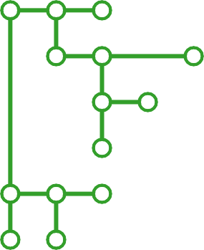
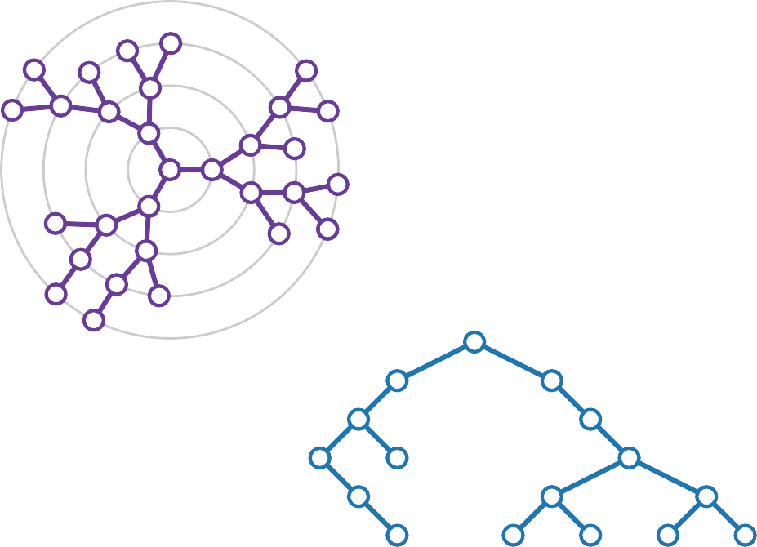
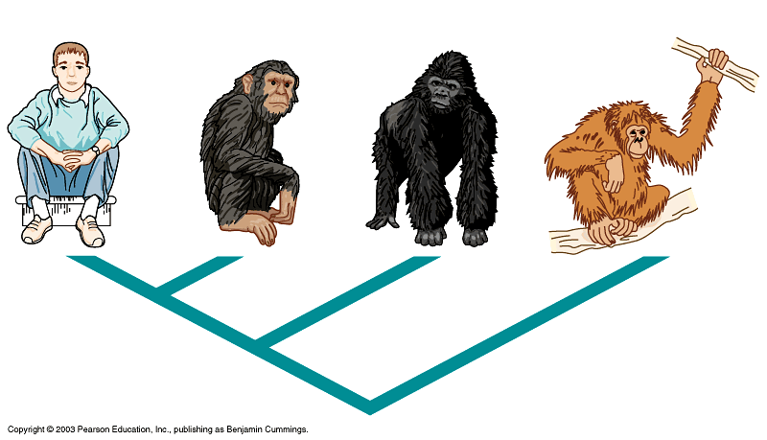
Tree Layout
Contains material from Philipp Kindermann

Slide 4
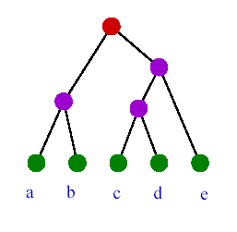
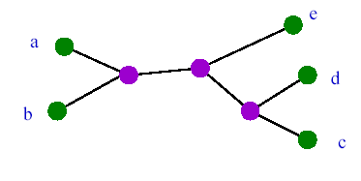
What types of trees are there?
A rooted tree reflects the direction of evolution
An unrooted tree shows
only connections between nodes
Time
If the number of leaves is n , there are (2 n -3)!!
different binary rooted trees.
By definition, (2 n -3)!! = 1·3·...·(2n-3)
There are (2 n -5)!! various rootless
trees with n leaves

Slide 5
UNROOTED
ROOTED
3 sheets
A
B
A
C
B
C
B
A
C
C
B
A
4 sheets
A
A
A
A
C
B
B
B
...
C
C
C
D
D
D
B
D
A
B
A
...
D
C
C
D
A
B
C
...
15 rooted trees with 4 leaves
B
D

Slide 6
How to draw a tree ? Tree topology
Tree topology - only leaves, nodes, (root) and branches connecting them (topology does not depend on the way the tree is depicted)
A
B
C
D
E
C
D
E
A
B
Two images of the same topology

Slide 7
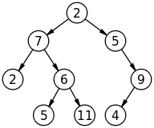
Rules for laying root trees
No crossing of ribs (planarity)
Straightness of ribs
Strict vertical monotonicity – the y- coordinate of the vertices is strictly greater than that of their descendants
Maintain descendant order
X _{left child} ≤ X _{vertex} ≤ X _{right child}

Slide 8
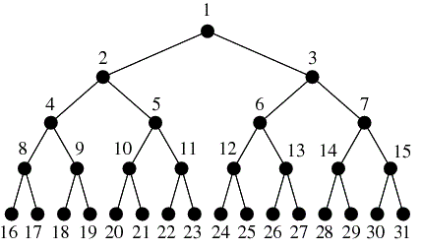
D. Knuth's algorithm
Right – Root – Left (RRL)
Step down, draw the right tree recursively;
Step up, step left, draw root
Step down, draw the left subtree recursively;
Possible options
Left-Root-Right,
Root-Left-Right,
Root-Right-Left

Slide 9
Requirements for vertical installation
Vertices have integer coordinates from ℤ ²
Edges – straight segments
The child has a larger coordinate than the parent ( Y axis points down)

Slide 10
Tree laying area
Theorem 1. The vertical stacking area of a tree has a lower bound of O ( n log n )

Slide 11
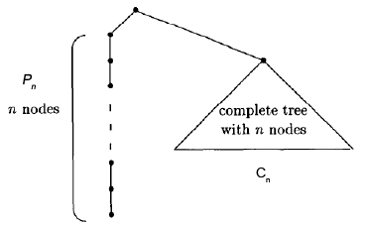
Proof
Consider a tree of the form t _{n} = P _{n} ⊕ C_{n​}
Height Cn​ equal to h ; n = 2 ^{h} - 1; h = log ₂ (n+1)
P _{n} – chain for n tops;

Slide 12
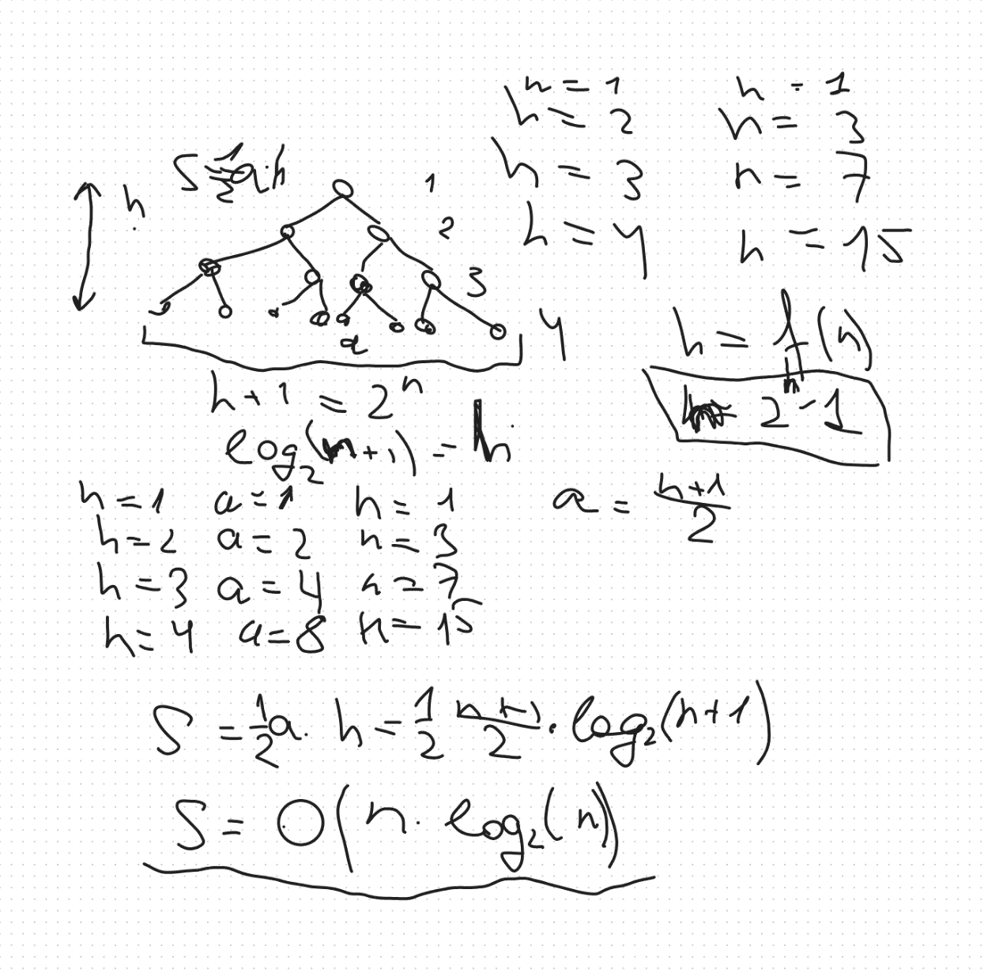
Area estimation

Slide 13
First Grid Layout of Binary Trees
2 - 1
Choose y-coordinates: y(u) =depth(u)
0
1
2
3
Choose x-coordinates:

Slide 14
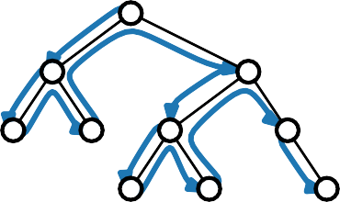
First Grid Layout of Binary Trees
2 - 2
Choose y-coordinates: y(u) =depth(u)
0
1
2
3
Choose x-coordinates:
preorder
0
1
2
3

Slide 15
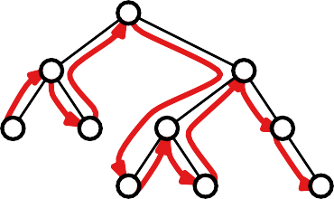
First Grid Layout of Binary Trees
2 - 3
Choose y-coordinates: y(u) =depth(u)
0
1
2
3
Choose x-coordinates:
preorder
inorder
0
1
2
3
0
1
2
3

Slide 16
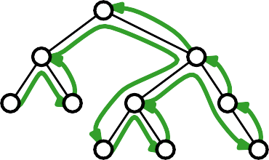
First Grid Layout of Binary Trees
2 - 4
Choose y-coordinates: y(u) =depth(u)
0
1
2
3
Choose x-coordinates:
preorder
inorder
postorder
0
1
2
3
0
1
2
3
0
1
2
3

Slide 17
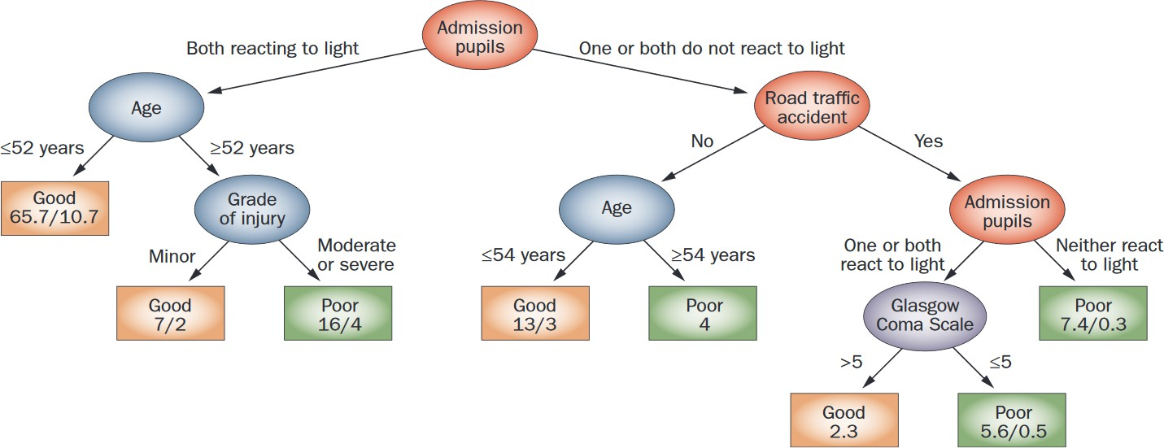
Layered Drawings – Applications
3 - 1
Decision tree for outcome prediction after traumatic brain injury
Source: Nature Reviews Neurology

Slide 18
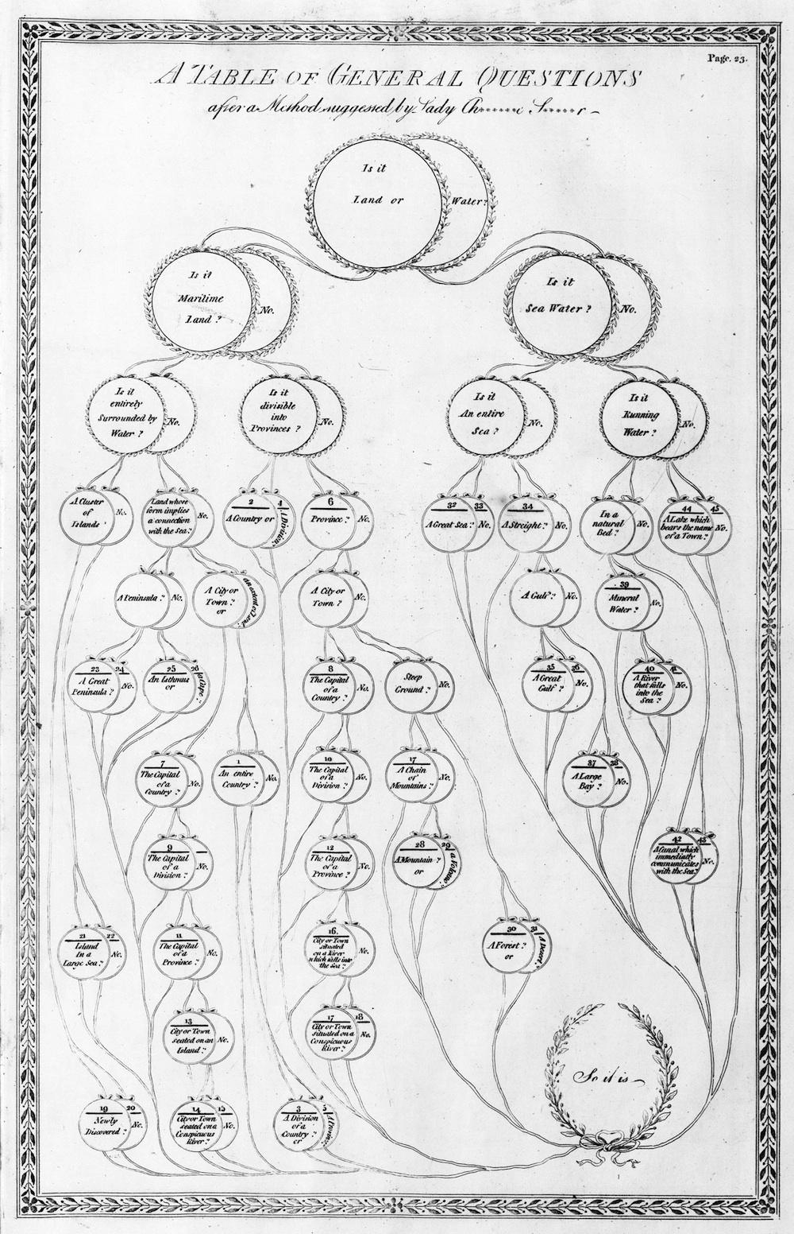
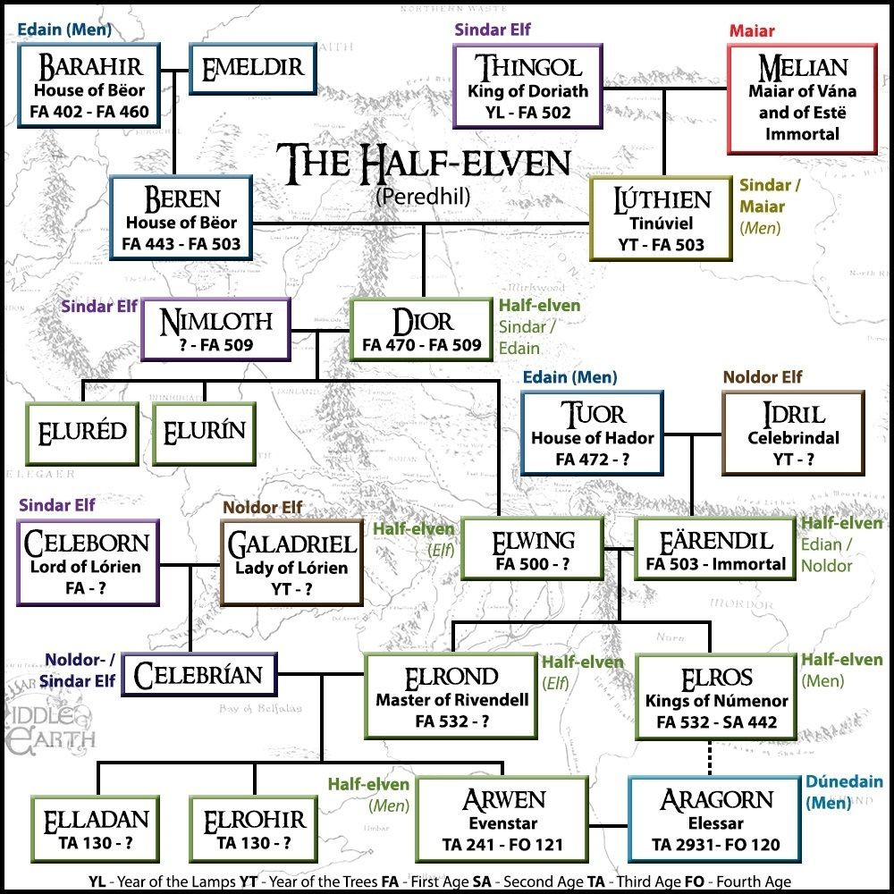
Layered Drawings – Applications
3 - 2
Family tree of LOTR elves and half-elves
Aloisius Gaultier 1821

Slide 19
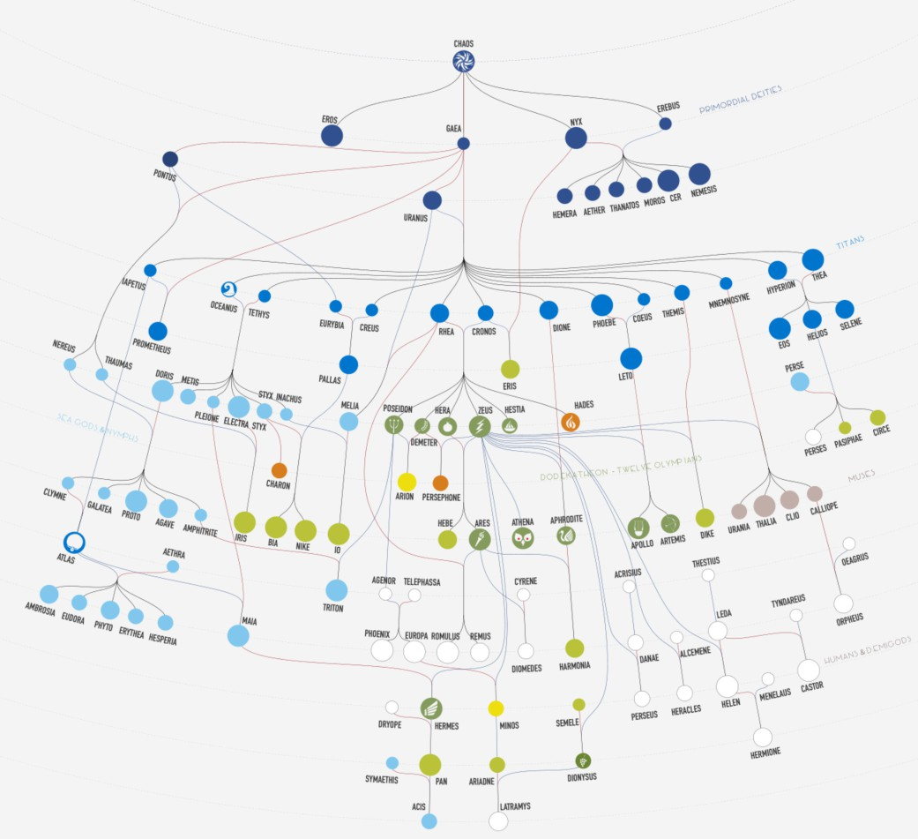
Layered Drawings – Applications
3 - 3
J. Klawitter, T. Mchedlidze, Link: go.uniwue.de/myth-poster

Slide 20
Layered Drawings – Drawing Style
0
1
2
3
4 - 1
What are properties of the layout?
■ What are the drawing conventions?
■ What are aesthetics to optimize?

Slide 21
Layered Drawings – Drawing Style
0
1
2
3
4 - 2
What are properties of the layout?
What are the drawing conventions?
■ What are aesthetics to optimize?

Slide 22
Layered Drawings – Drawing Style
0
1
2
3
4 - 3
What are properties of the layout?
What are the drawing conventions?
What are aesthetics to optimize?

Slide 23
Layered Drawings – Drawing Style
0
1
2
3
4 - 4
Drawing conventions
What are properties of the layout?
What are the drawing conventions?
What are aesthetics to optimize?

Slide 24
Layered Drawings – Drawing Style
0
1
2
3
4 - 5
Drawing conventions
Vertices lie on layers
and have integer coordinates
What are properties of the layout?
What are the drawing conventions?
What are aesthetics to optimize?

Slide 25
Layered Drawings – Drawing Style
0
1
2
3
4 - 6
Drawing conventions
Vertices lie on layers
and have integer coordinates
Parent centered above children
What are properties of the layout?
What are the drawing conventions?
What are aesthetics to optimize?

Slide 26
Layered Drawings – Drawing Style
0
1
2
3
4 - 7
Drawing conventions
Vertices lie on layers
and have integer coordinates
Parent centered above children
Edges are straight-line segments
What are properties of the layout?
What are the drawing conventions?
What are aesthetics to optimize?

Slide 27
Layered Drawings – Drawing Style
0
1
2
3
4 - 8
Drawing conventions
Vertices lie on layers
and have integer coordinates
Parent centered above children
Edges are straight-line segments
Isomorphic subtrees have identi- cal drawings
What are properties of the layout?
What are the drawing conventions?
What are aesthetics to optimize?

Slide 28
Layered Drawings – Drawing Style
0
1
2
3
4 - 9
Drawing conventions
Vertices lie on layers
and have integer coordinates
Parent centered above children
Edges are straight-line segments
Isomorphic subtrees have identi- cal drawings
What are properties of the layout?
What are the drawing conventions?
What are aesthetics to optimize?

Slide 29

Layered Drawings – Drawing Style
0
1
2
3
4 - 10
Drawing conventions
Vertices lie on layers
and have integer coordinates
Parent centered above children
Edges are straight-line segments
Isomorphic subtrees have identi- cal drawings
What are properties of the layout?
What are the drawing conventions?
What are aesthetics to optimize?

Slide 30
Layered Drawings – Drawing Style
0
1
2
3
4 - 11
Drawing conventions
Vertices lie on layers
and have integer coordinates
Parent centered above children
Edges are straight-line segments
Isomorphic subtrees have identi- cal drawings
What are properties of the layout?
What are the drawing conventions?
What are aesthetics to optimize?
Drawing aesthetics

Slide 31
Layered Drawings – Drawing Style
0
1
2
3
4 - 12
Drawing conventions
Vertices lie on layers
and have integer coordinates
Parent centered above children
Edges are straight-line segments
Isomorphic subtrees have identi- cal drawings
What are properties of the layout?
What are the drawing conventions?
What are aesthetics to optimize?
Drawing aesthetics
Area

Slide 32
Layered Drawings – Drawing Style
0
1
2
3
4 - 13
Drawing conventions
Vertices lie on layers
and have integer coordinates
Parent centered above children
Edges are straight-line segments
Isomorphic subtrees have identi- cal drawings
What are properties of the layout?
What are the drawing conventions?
What are aesthetics to optimize?
Drawing aesthetics
Area
Symmetries

Slide 33
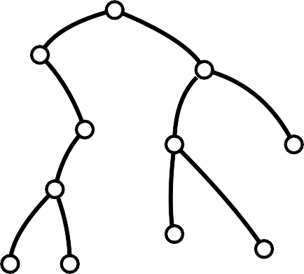
Layered Drawings – Algorithm
5 - 1
Input: A binary tree T
Output: A layered drawing of T

Slide 34
Layered Drawings – Algorithm
5 - 2
Input: A binary tree T
Output: A layered drawing of T
Base case:
Divide: Recursively apply the algorithm to draw the left and right subtrees
Conquer:
A single vertex

Slide 35

Layered Drawings – Algorithm
5 - 3
Input: A binary tree T
Output: A layered drawing of T
Base case: A single vertex
Divide: Recursively apply the algorithm to draw the left and right subtrees
Conquer:

Slide 36
Layered Drawings – Algorithm
5 - 4
Input: A binary tree T
Output: A layered drawing of T
Base case: A single vertex
Divide: Recursively apply the algorithm to draw the left and right subtrees
Conquer:

Slide 37
Layered Drawings – Algorithm
5 - 5
Input: A binary tree T
Output: A layered drawing of T
Base case: A single vertex
Divide: Recursively apply the algorithm to draw the left and right subtrees
Conquer:

Slide 38
Layered Drawings – Algorithm
5 - 6
Input: A binary tree T
Output: A layered drawing of T
Base case: A single vertex
Divide: Recursively apply the algorithm to draw the left and right subtrees
Conquer:

Slide 39







Layered Drawings – Algorithm
5 - 7
Input: A binary tree T
Output: A layered drawing of T
Base case: A single vertex
Divide: Recursively apply the algorithm to draw the left and right subtrees
Conquer:

Slide 40


Layered Drawings – Algorithm
5 - 8
Input: A binary tree T
Output: A layered drawing of T
Base case: A single vertex
Divide: Recursively apply the algorithm to draw the left and right subtrees
Conquer:

Slide 41

Layered Drawings – Algorithm
5 - 9
Input: A binary tree T
Output: A layered drawing of T
Base case: A single vertex
Divide: Recursively apply the algorithm to draw the left and right subtrees
Conquer:
2
some agreed distance

Slide 42

Layered Drawings – Algorithm
5 - 10
Input: A binary tree T
Output: A layered drawing of T
Base case: A single vertex
Divide: Recursively apply the algorithm to draw the left and right subtrees
Conquer:
parent centered wrt to children
2
some agreed distance

Slide 43
Layered Drawings – Algorithm
5 - 11
Input: A binary tree T
Output: A layered drawing of T
Base case: A single vertex
Divide: Recursively apply the algorithm to draw the left and right subtrees
Conquer:
parent centered wrt to children
2
some agreed distance
sometimes 3 apart for grid drawing!

Slide 44

Layered Drawings – Algorithm Details
7 - 1
Phase 1 – postorder traversal:
For each vertex compute horizontal displacement of left and right child
v
v_{l}
v_{r}

Slide 45
Layered Drawings – Algorithm Details
7 - 2
Phase 1 – postorder traversal:
For each vertex compute horizontal displacement of left and right child
v
v_{l}
v_{r}
Phase 2 – preorder traversal:
Compute x- and y-coordinates

Slide 46
Layered Drawings – Algorithm Details
7 - 3
Phase 1 – postorder traversal:
For each vertex compute horizontal displacement of left and right child
v
v_{l}
v_{r}
−1
+1
Phase 2 – preorder traversal:
Compute x- and y-coordinates

Slide 47
Layered Drawings – Algorithm Details
7 - 4
Phase 1 – postorder traversal:
For each vertex compute horizontal displacement of left and right child
v
v_{l}
v_{r}
+1
−1
+1
Phase 2 – preorder traversal:
Compute x- and y-coordinates

Slide 48
Layered Drawings – Algorithm Details
7 - 5
Phase 1 – postorder traversal:
For each vertex compute horizontal displacement of left and right child
v
v_{l}
v_{r}
−1
+1
−1
+1
Phase 2 – preorder traversal:
Compute x- and y-coordinates

Slide 49
Layered Drawings – Algorithm Details
7 - 6
Phase 1 – postorder traversal:
For each vertex compute horizontal displacement of left and right child
v
v_{l}
v_{r}
−1
+1
−1 +1
−1
+1
Phase 2 – preorder traversal:
Compute x- and y-coordinates

Slide 50
Layered Drawings – Algorithm Details
7 - 7
Phase 1 – postorder traversal:
For each vertex compute horizontal displacement of left and right child
v
v_{l}
v_{r}
−1
−1
+1
+1
−1 +1
−1
+1
Phase 2 – preorder traversal:
Compute x- and y-coordinates

Slide 51
Layered Drawings – Algorithm Details
7 - 8
Phase 1 – postorder traversal:
For each vertex compute horizontal displacement of left and right child
v
v_{l}
?
?
v_{r}
−1
−1
+1
+1
−1 +1
−1
+1
Phase 2 – preorder traversal:
Compute x- and y-coordinates

Slide 52
Layered Drawings – Algorithm Details
7 - 9
Phase 1 – postorder traversal:
For each vertex compute horizontal displacement of left and right child
v
v_{l}
?
?
v_{r}
−1
−1
+1
+1
−1 +1
−1
+1
At vertex u (below v) store left and right contour of subtree T(u)
Contour is linked list of vertex coordinates/offsets
Phase 2 – preorder traversal:
Compute x- and y-coordinates

Slide 53

Layered Drawings – Algorithm Details
7 - 10
Phase 1 – postorder traversal:
For each vertex compute horizontal displacement of left and right child
v
v_{l}
?
?
v_{r}
−1
−1
+1
+1
−1 +1
−1
+1
At vertex u (below v) store left and right contour of subtree T(u)
Contour is linked list of vertex coordinates/offsets
v
v_{l}
v_{r}
Phase 2 – preorder traversal:
Compute x- and y-coordinates

Slide 54
Layered Drawings – Algorithm Details
7 - 11
Phase 1 – postorder traversal:
For each vertex compute horizontal displacement of left and right child
v
v_{l}
?
?
v_{r}
−1
−1
+1
+1
−1 +1
−1
+1
At vertex u (below v) store left and right contour of subtree T(u)
Contour is linked list of vertex coordinates/offsets
v
v_{l}
v_{r}
Phase 2 – preorder traversal:
Compute x- and y-coordinates

Slide 55
Layered Drawings – Algorithm Details
7 - 12
Phase 1 – postorder traversal:
For each vertex compute horizontal displacement of left and right child
v
v_{l}
?
?
v_{r}
−1
−1
+1
+1
−1 +1
−1
+1
At vertex u (below v) store left and right contour of subtree T(u)
Contour is linked list of vertex coordinates/offsets
v
v_{l}
v_{r}
Phase 2 – preorder traversal:
Compute x- and y-coordinates

Slide 56
Layered Drawings – Algorithm Details
7 - 13
Phase 1 – postorder traversal:
For each vertex compute horizontal displacement of left and right child
v
v_{l}
?
?
v_{r}
−1
−1
+1
+1
−1 +1
−1
+1
At vertex u (below v) store left and right contour of subtree T(u)
Contour is linked list of vertex coordinates/offsets
v
v_{l}
v_{r}
Phase 2 – preorder traversal:
Compute x- and y-coordinates

Slide 57
Layered Drawings – Algorithm Details
7 - 14
Phase 1 – postorder traversal:
For each vertex compute horizontal displacement of left and right child
v
v_{l}
?
?
v_{r}
−1
−1
+1
+1
−1 +1
−1
+1
At vertex u (below v) store left and right contour of subtree T(u)
Contour is linked list of vertex coordinates/offsets
v
v_{l}
v_{r}
Phase 2 – preorder traversal:
Compute x- and y-coordinates

Slide 58
Layered Drawings – Algorithm Details
7 - 15
Phase 1 – postorder traversal:
For each vertex compute horizontal displacement of left and right child
v
v_{l}
?
?
v_{r}
−1
−1
+1
+1
−1 +1
−1
+1
At vertex u (below v) store left and right contour of subtree T(u)
Contour is linked list of vertex coordinates/offsets
v
v_{l}
v_{r}
Phase 2 – preorder traversal:
Compute x- and y-coordinates

Slide 59
Layered Drawings – Algorithm Details
7 - 16
Phase 1 – postorder traversal:
For each vertex compute horizontal displacement of left and right child
v
v_{l}
?
?
v_{r}
−1
−1
+1
+1
−1 +1
At vertex u (below v) store left and right contour of subtree T(u)
Contour is linked list of vertex coordinates/offsets
Find d_{v} = min. horiz. distance between v_{l} and v_{r}
Phase 2 – preorder traversal:
Compute x- and y-coordinates
−1
+1
v
v_{l}
v_{r}

Slide 60
Layered Drawings – Algorithm Details
7 - 17
Phase 1 – postorder traversal:
For each vertex compute horizontal displacement of left and right child
v
v_{l}
?
?
v_{r}
−1
−1
+1
+1
−1 +1
At vertex u (below v) store left and right contour of subtree T(u)
Contour is linked list of vertex coordinates/offsets
Find d_{v} = min. horiz. distance between v_{l} and v_{r}
Phase 2 – preorder traversal:
Compute x- and y-coordinates
+1
−1
v
v_{l}
v_{r}

Slide 61
Layered Drawings – Algorithm Details
7 - 18
Phase 1 – postorder traversal:
For each vertex compute horizontal displacement of left and right child
v
v_{l}
?
?
v_{r}
−1
−1
+1
At vertex u (below v) store left and right contour of subtree T(u)
Contour is linked list of vertex coordinates/offsets
Find d_{v} = min. horiz. distance between v_{l} and v_{r}
Phase 2 – preorder traversal:
Compute x- and y-coordinates
+1
−1 +1
−1
+1
v
v_{l}
2
v_{r}

Slide 62

Layered Drawings – Algorithm Details
7 - 19
Phase 1 – postorder traversal:
For each vertex compute horizontal displacement of left and right child
v
v_{l}
?
?
v_{r}
−1
−1
+1
At vertex u (below v) store left and right contour of subtree T(u)
Contour is linked list of vertex coordinates/offsets
Find d_{v} = min. horiz. distance between v_{l} and v_{r}
Phase 2 – preorder traversal:
Compute x- and y-coordinates
+1
−1 +1
−1
+1
v
v_{l}
2
v_{r}

Slide 63

Layered Drawings – Algorithm Details
7 - 20
Phase 1 – postorder traversal:
For each vertex compute horizontal displacement of left and right child
v
v_{l}
?
?
v_{r}
−1
−1
+1
At vertex u (below v) store left and right contour of subtree T(u)
Contour is linked list of vertex coordinates/offsets
Find d_{v} = min. horiz. distance between v_{l} and v_{r}
Phase 2 – preorder traversal:
Compute x- and y-coordinates
+1
−1 +1
−1
+1
v
v_{l}
2
v_{r}

Slide 64
Layered Drawings – Algorithm Details
7 - 21
Phase 1 – postorder traversal:
For each vertex compute horizontal displacement of left and right child
v
v_{l}
?
?
v_{r}
−1
−1
+1
At vertex u (below v) store left and right contour of subtree T(u)
Contour is linked list of vertex coordinates/offsets
Find d_{v} = min. horiz. distance between v_{l} and v_{r}
Phase 2 – preorder traversal:
Compute x- and y-coordinates
+1
−1 +1
−1
+1
v
v_{l}
4
v_{r}

Slide 65
Layered Drawings – Algorithm Details
7 - 22
Phase 1 – postorder traversal:
For each vertex compute horizontal displacement of left and right child
v
v_{l}
−2
+2
v_{r}
−1
−1
+1
x-offset(v ) = −r
d
v
l, x-offset(v ) = r
d
v
l
+1
−1 +1
l
r
2 2
−1
+1
At vertex u (below v) store left and right contour of subtree T(u)
Contour is linked list of vertex coordinates/offsets
Find d_{v} = min. horiz. distance between v_{l} and v_{r}
Phase 2 – preorder traversal:
Compute x- and y-coordinates
v
v_{l}
4
v_{r}

Slide 66
Layered Drawings – Algorithm Details
7 - 23
Phase 1 – postorder traversal:
For each vertex compute horizontal displacement of left and right child
v
v_{l}
−2
+2 _{vr}
−1
−1 +1
x-offset(v ) = −r
d
v
l, x-offset(v ) = r
d
v
l
+1 −1 +1
l
r
2 2
−1
+1
At vertex u (below v) store left and right contour of subtree T(u)
Contour is linked list of vertex coordinates/offsets
Find d_{v} = min. horiz. distance between v_{l} and v_{r}
Phase 2 – preorder traversal:
Compute x- and y-coordinates
v
v_{l}
4
v_{r}

Slide 67
Layered Drawings – Algorithm Details
7 - 24
Phase 1 – postorder traversal:
For each vertex compute horizontal displacement of left and right child
v
v_{l}
−2
+2 _{vr}
−1
−1 +1
x-offset(v ) = −r
d
v
l, x-offset(v ) = r
d
v
l
+1 −1 +1
l
r
2 2
−1
+1
At vertex u (below v) store left and right contour of subtree T(u)
Contour is linked list of vertex coordinates/offsets
Find d_{v} = min. horiz. distance between v_{l} and v_{r}
Phase 2 – preorder traversal:
Compute x- and y-coordinates
v
v_{l}
4
v_{r}

Slide 68
Layered Drawings – Algorithm Details
7 - 25
Phase 1 – postorder traversal:
For each vertex compute horizontal displacement of left and right child
v
v_{l}
−2
+2 _{vr}
−1
−1 +1
x-offset(v ) = −r
d
v
l, x-offset(v ) = r
d
v
l
+1 −1 +1
l
r
2 2
−1
+1
At vertex u (below v) store left and right contour of subtree T(u)
Contour is linked list of vertex coordinates/offsets
Find d_{v} = min. horiz. distance between v_{l} and v_{r}
Phase 2 – preorder traversal:
Compute x- and y-coordinates
Runtime?
v
v_{l}
4
v_{r}
■ How often do we have to walk along a contour?

Slide 69
Layered Drawings – Algorithm Details
7 - 26
Phase 1 – postorder traversal:
For each vertex compute horizontal displacement of left and right child
v
v_{l}
−2
+2 _{vr}
−1
−1 +1
x-offset(v ) = −r
d
v
l, x-offset(v ) = r
d
v
l
+1 −1 +1
l
r
2 2
−1
+1
At vertex u (below v) store left and right contour of subtree T(u)
Contour is linked list of vertex coordinates/offsets
Find d_{v} = min. horiz. distance between v_{l} and v_{r}
Phase 2 – preorder traversal:
Compute x- and y-coordinates
Runtime?
How often do we have to walk along a contour?
v
v_{l}
4
v_{r}

Slide 70
Layered Drawings – Algorithm Details
7 - 27
Phase 1 – postorder traversal:
For each vertex compute horizontal displacement of left and right child
v
v_{l}
−2
+2 _{vr}
−1
−1 +1
x-offset(v ) = −r
d
v
l, x-offset(v ) = r
d
v
l
+1 −1 +1
l
r
2 2
−1
+1
At vertex u (below v) store left and right contour of subtree T(u)
Contour is linked list of vertex coordinates/offsets
Find d_{v} = min. horiz. distance between v_{l} and v_{r}
Phase 2 – preorder traversal:
Compute x- and y-coordinates
Runtime?
How often do we have to walk along a contour?
v
v_{l}
4
v_{r}

Slide 71
Layered Drawings – Algorithm Details
7 - 28
Phase 1 – postorder traversal:
For each vertex compute horizontal displacement of left and right child
v
v_{l}
−2
+2 _{vr}
−1
−1 +1
x-offset(v ) = −r
d
v
l, x-offset(v ) = r
d
v
l
+1 −1 +1
l
r
2 2
−1
+1
At vertex u (below v) store left and right contour of subtree T(u)
Contour is linked list of vertex coordinates/offsets
Find d_{v} = min. horiz. distance between v_{l} and v_{r}
Phase 2 – preorder traversal:
Compute x- and y-coordinates
Runtime?
How often do we have to walk along a contour?
v
v_{l}
4
v_{r}

Slide 72
Layered Drawings – Algorithm Details
7 - 29
Phase 1 – postorder traversal:
For each vertex compute horizontal displacement of left and right child
v
v_{l}
−2
+2 _{vr}
−1
−1 +1
x-offset(v ) = −r
d
v
l, x-offset(v ) = r
d
v
l
+1 −1 +1
l
r
2 2
−1
+1
At vertex u (below v) store left and right contour of subtree T(u)
Contour is linked list of vertex coordinates/offsets
Find d_{v} = min. horiz. distance between v_{l} and v_{r}
Phase 2 – preorder traversal:
Compute x- and y-coordinates
Runtime?
How often do we have to walk along a contour?
v
v_{l}
4
v_{r}

Slide 73
Layered Drawings – Algorithm Details
7 - 30
Phase 1 – postorder traversal:
For each vertex compute horizontal displacement of left and right child
v
v_{l}
−2
+2 _{vr}
−1
−1 +1
x-offset(v ) = −r
d
v
l, x-offset(v ) = r
d
v
l
+1 −1 +1
l
r
2 2
−1
+1
At vertex u (below v) store left and right contour of subtree T(u)
Contour is linked list of vertex coordinates/offsets
Find d_{v} = min. horiz. distance between v_{l} and v_{r}
Phase 2 – preorder traversal:
Compute x- and y-coordinates
Runtime?
How often do we have to walk along a contour?
v
v_{l}
4
v_{r}

Slide 74
Layered Drawings – Algorithm Details
7 - 31
Phase 1 – postorder traversal:
For each vertex compute horizontal displacement of left and right child
v
v_{l}
−2
+2 _{vr}
−1
−1 +1
x-offset(v ) = −r
d
v
l, x-offset(v ) = r
d
v
l
+1 −1 +1
l
r
2 2
−1
+1
At vertex u (below v) store left and right contour of subtree T(u)
Contour is linked list of vertex coordinates/offsets
Find d_{v} = min. horiz. distance between v_{l} and v_{r}
Phase 2 – preorder traversal:
Compute x- and y-coordinates
Runtime?
How often do we have to walk along a contour?
v
v_{l}
4
v_{r}

Slide 75
Layered Drawings – Algorithm Details
7 - 32
Phase 1 – postorder traversal:
For each vertex compute horizontal displacement of left and right child
v
v_{l}
−2
+2 _{vr}
−1
−1 +1
x-offset(v ) = −r
d
v
l, x-offset(v ) = r
d
v
l
+1 −1 +1
l
r
2 2
−1
+1
At vertex u (below v) store left and right contour of subtree T(u)
Contour is linked list of vertex coordinates/offsets
Find d_{v} = min. horiz. distance between v_{l} and v_{r}
Phase 2 – preorder traversal:
Compute x- and y-coordinates
Runtime?
How often do we have to walk along a contour?
v
v_{l}
4
v_{r}

Slide 76
Layered Drawings – Algorithm Details
7 - 33
Phase 1 – postorder traversal:
For each vertex compute horizontal displacement of left and right child
v
v_{l}
−2
+2 _{vr}
−1
−1 +1
x-offset(v ) = −r
d
v
l, x-offset(v ) = r
d
v
l
+1 −1 +1
l
r
2 2
−1
+1
At vertex u (below v) store left and right contour of subtree T(u)
Contour is linked list of vertex coordinates/offsets
Find d_{v} = min. horiz. distance between v_{l} and v_{r}
Phase 2 – preorder traversal:
Compute x- and y-coordinates
Runtime?
How often do we have to walk along a contour?
v
v_{l}
4
v_{r}
⇒ O(n)

Slide 77
Layered Drawings – Result
8 - 1
Theorem. [Reingold & Tilford ’81] Let T be a binary tree with n vertices. We can construct a drawing Γ of T in O(n) time, such that:
■ Γ is planar, straight-line and strictly downward
■ Γ is layered: y-coordinate of vertex v is −depth(v)
■ Horizontal and Vertical distances are at least 1
■ Each vertex is centred wrt its children
Area of Γ is in O(n²) – but not optimal!
■
■ Simply isomorphic subtrees have congruent drawings, up to translation
■ Axially isomorphic subtrees have congruent drawings, up to translation and reflection

Slide 78
Layered Drawings – Result
8 - 2
Theorem. [Reingold & Tilford ’81] Let T be a binary tree with n vertices. We can construct a drawing Γ of T in O(n) time, such that:
Γ is planar, straight-line and strictly downward
■ Γ is layered: y-coordinate of vertex v is −depth(v)
■ Horizontal and Vertical distances are at least 1
■ Each vertex is centred wrt its children
Area of Γ is in O(n²) – but not optimal!
■
■ Simply isomorphic subtrees have congruent drawings, up to translation
■ Axially isomorphic subtrees have congruent drawings, up to translation and reflection

Slide 79
Layered Drawings – Result
8 - 3
Theorem. [Reingold & Tilford ’81] Let T be a binary tree with n vertices. We can construct a drawing Γ of T in O(n) time, such that:
Γ is planar, straight-line and strictly downward
Γ is layered: y-coordinate of vertex v is −depth(v)
■ Horizontal and Vertical distances are at least 1
■ Each vertex is centred wrt its children
Area of Γ is in O(n²) – but not optimal!
■
■ Simply isomorphic subtrees have congruent drawings, up to translation
■ Axially isomorphic subtrees have congruent drawings, up to translation and reflection

Slide 80
Layered Drawings – Result
8 - 4
Theorem. [Reingold & Tilford ’81] Let T be a binary tree with n vertices. We can construct a drawing Γ of T in O(n) time, such that:
Γ is planar, straight-line and strictly downward
Γ is layered: y-coordinate of vertex v is −depth(v)
Horizontal and Vertical distances are at least 1
■ Each vertex is centred wrt its children
Area of Γ is in O(n²) – but not optimal!
■
■ Simply isomorphic subtrees have congruent drawings, up to translation
■ Axially isomorphic subtrees have congruent drawings, up to translation and reflection

Slide 81
Layered Drawings – Result
8 - 5
Theorem. [Reingold & Tilford ’81] Let T be a binary tree with n vertices. We can construct a drawing Γ of T in O(n) time, such that:
Γ is planar, straight-line and strictly downward
Γ is layered: y-coordinate of vertex v is −depth(v)
Horizontal and Vertical distances are at least 1
Each vertex is centred wrt its children
■ Area of Γ is in O(n²) – but not optimal!
■ Simply isomorphic subtrees have congruent drawings, up to translation
■ Axially isomorphic subtrees have congruent drawings, up to translation and reflection

Slide 82
Layered Drawings – Result
8 - 6
Theorem. [Reingold & Tilford ’81] Let T be a binary tree with n vertices. We can construct a drawing Γ of T in O(n) time, such that:
Γ is planar, straight-line and strictly downward
Γ is layered: y-coordinate of vertex v is −depth(v)
Horizontal and Vertical distances are at least 1
Each vertex is centred wrt its children
Area of Γ is in O(n²)
– but not optimal!
■ Simply isomorphic subtrees have congruent
drawings, up to translation
■ Axially isomorphic subtrees have congruent drawings, up to translation and reflection

Slide 83
Layered Drawings – Result
8 - 7
Theorem. [Reingold & Tilford ’81] Let T be a binary tree with n vertices. We can construct a drawing Γ of T in O(n) time, such that:
Γ is planar, straight-line and strictly downward
Γ is layered: y-coordinate of vertex v is −depth(v)
Horizontal and Vertical distances are at least 1
Each vertex is centred wrt its children
Area of Γ is in O(n²) – but not optimal!
■ Simply isomorphic subtrees have congruent
drawings, up to translation
■ Axially isomorphic subtrees have congruent drawings, up to translation and reflection

Slide 84

Layered Drawings – Result
8 - 8
Theorem. [Reingold & Tilford ’81] Let T be a binary tree with n vertices. We can construct a drawing Γ of T in O(n) time, such that:
Γ is planar, straight-line and strictly downward
Γ is layered: y-coordinate of vertex v is −depth(v)
Horizontal and Vertical distances are at least 1
Each vertex is centred wrt its children
Area of Γ is in O(n²) – but not optimal!
■ Simply isomorphic subtrees have congruent
drawings, up to translation
■ Axially isomorphic subtrees have congruent drawings, up to translation and reflection

Slide 85
Layered Drawings – Result
8 - 9
Theorem. [Reingold & Tilford ’81] Let T be a binary tree with n vertices. We can construct a drawing Γ of T in O(n) time, such that:
Γ is planar, straight-line and strictly downward
Γ is layered: y-coordinate of vertex v is −depth(v)
Horizontal and Vertical distances are at least 1
Each vertex is centred wrt its children
Area of Γ is in O(n²) – but not optimal!
■ Simply isomorphic subtrees have congruent
drawings, up to translation
■ Axially isomorphic subtrees have congruent drawings, up to translation and reflection

Slide 86
Layered Drawings – Result
8 - 10
Theorem. [Reingold & Tilford ’81] Let T be a binary tree with n vertices. We can construct a drawing Γ of T in O(n) time, such that:
Γ is planar, straight-line and strictly downward
Γ is layered: y-coordinate of vertex v is −depth(v)
Horizontal and Vertical distances are at least 1
Each vertex is centred wrt its children
Area of Γ is in O(n²) – but not optimal!
■ Simply isomorphic subtrees have congruent
drawings, up to translation
■ Axially isomorphic subtrees have congruent drawings, up to translation and reflection

Slide 87
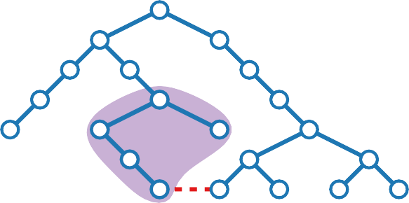
Layered Drawings – Result
8 - 11
Theorem. [Reingold & Tilford ’81] Let T be a binary tree with n vertices. We can construct a drawing Γ of T in O(n) time, such that:
Γ is planar, straight-line and strictly downward
Γ is layered: y-coordinate of vertex v is −depth(v)
Horizontal and Vertical distances are at least 1
Each vertex is centred wrt its children
Area of Γ is in O(n²) – but not optimal!
■ Simply isomorphic subtrees have congruent
drawings, up to translation
■ Axially isomorphic subtrees have congruent drawings, up to translation and reflection

Slide 88

Layered Drawings – Result
8 - 12
Theorem. [Reingold & Tilford ’81] Let T be a binary tree with n vertices. We can construct a drawing Γ of T in O(n) time, such that:
Γ is planar, straight-line and strictly downward
Γ is layered: y-coordinate of vertex v is −depth(v)
Horizontal and Vertical distances are at least 1
Each vertex is centred wrt its children
Area of Γ is in O(n²) – but not optimal!
NP-hard
■ Simply isomorphic subtrees have congruent
drawings, up to translation
■ Axially isomorphic subtrees have congruent drawings, up to translation and reflection

Slide 89
Layered Drawings – Result
8 - 13
Theorem. [Reingold & Tilford ’81] Let T be a binary tree with n vertices. We can construct a drawing Γ of T in O(n) time, such that:
Γ is planar, straight-line and strictly downward
Γ is layered: y-coordinate of vertex v is −depth(v)
Horizontal and Vertical distances are at least 1
Each vertex is centred wrt its children
Area of Γ is in O(n²) – but not optimal!
NP-hard
■
Simply isomorphic
subtrees have congruent
drawings, up to translation
■ Axially isomorphic subtrees have congruent
drawings, up to translation and reflection

Slide 90
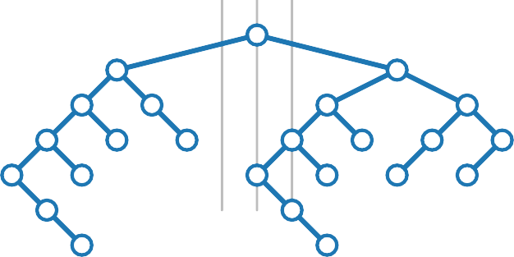
Layered Drawings – Result
8 - 14
Theorem. [Reingold & Tilford ’81] Let T be a binary tree with n vertices. We can construct a drawing Γ of T in O(n) time, such that:
Γ is planar, straight-line and strictly downward
Γ is layered: y-coordinate of vertex v is −depth(v)
Horizontal and Vertical distances are at least 1
Each vertex is centred wrt its children
Area of Γ is in O(n²) – but not optimal!
NP-hard
■
Simply isomorphic
subtrees have congruent
drawings, up to translation
■ Axially isomorphic subtrees have congruent
drawings, up to translation and reflection

Slide 91
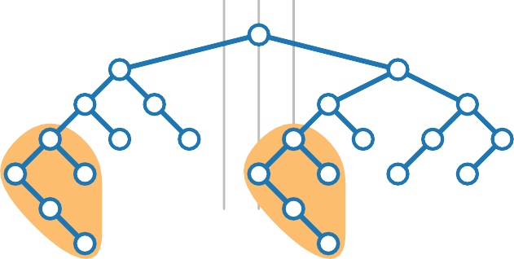
Layered Drawings – Result
8 - 15
Theorem. [Reingold & Tilford ’81] Let T be a binary tree with n vertices. We can construct a drawing Γ of T in O(n) time, such that:
Γ is planar, straight-line and strictly downward
Γ is layered: y-coordinate of vertex v is −depth(v)
Horizontal and Vertical distances are at least 1
Each vertex is centred wrt its children
Area of Γ is in O(n²) – but not optimal!
NP-hard
■
Simply isomorphic
subtrees have congruent
drawings, up to translation
■ Axially isomorphic subtrees have congruent
drawings, up to translation and reflection

Slide 92
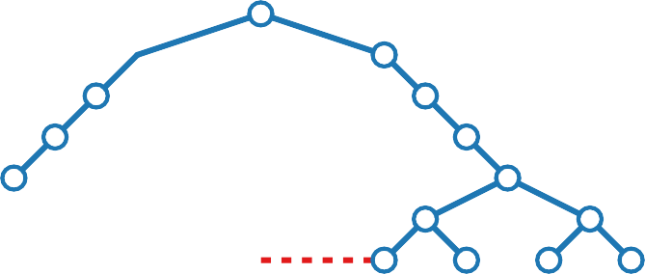
Layered Drawings – Result
8 - 16
Theorem. [Reingold & Tilford ’81] Let T be a binary tree with n vertices. We can construct a drawing Γ of T in O(n) time, such that:
Γ is planar, straight-line and strictly downward
Γ is layered: y-coordinate of vertex v is −depth(v)
Horizontal and Vertical distances are at least 1
Each vertex is centred wrt its children
Area of Γ is in O(n²) – but not optimal!
NP-hard
■
Simply isomorphic
subtrees have congruent
drawings, up to translation
■
Axially isomorphic
subtrees have congruent
drawings, up to translation and reflection

Slide 93
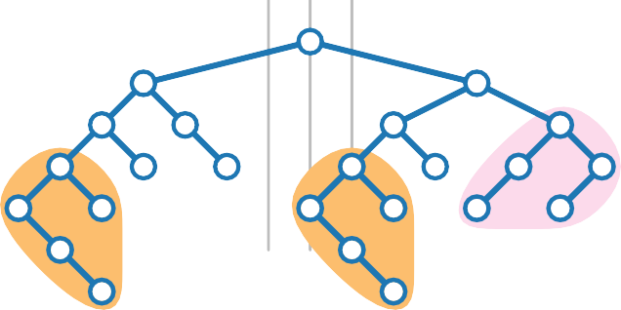
Layered Drawings – Result
8 - 17
Theorem. [Reingold & Tilford ’81] Let T be a binary tree with n vertices. We can construct a drawing Γ of T in O(n) time, such that:
Γ is planar, straight-line and strictly downward
Γ is layered: y-coordinate of vertex v is −depth(v)
Horizontal and Vertical distances are at least 1
Each vertex is centred wrt its children
Area of Γ is in O(n²) – but not optimal!
NP-hard
■
Simply isomorphic
subtrees have congruent
drawings, up to translation
■
Axially isomorphic
subtrees have congruent
drawings, up to translation and reflection

Slide 94
Layered Drawings – Result
8 - 18
Theorem. [Reingold & Tilford ’81]
rooted
Let T be a binary tree with n vertices. We can construct a drawing Γ of T in O(n) time, such that:
Γ is planar, straight-line and strictly downward
Γ is layered: y-coordinate of vertex v is −depth(v)
Horizontal and Vertical distances are at least 1
Each vertex is centred wrt its children
Area of Γ is in O(n²) – but not optimal!
NP-hard
■
Simply isomorphic
subtrees have congruent
drawings, up to translation
■
Axially isomorphic
subtrees have congruent
drawings, up to translation and reflection

Slide 95
Layered Drawings – Result
8 - 19
Theorem. [Reingold & Tilford ’81]
rooted
Let T be a binary tree with n vertices. We can construct a drawing Γ of T in O(n) time, such that:
Γ is planar, straight-line and strictly downward
Γ is layered: y-coordinate of vertex v is −depth(v)
Horizontal and Vertical distances are at least 1
Each vertex is centred wrt its children
Area of Γ is in O(n²) – but not optimal!
NP-hard
■
Simply isomorphic
subtrees have congruent
drawings, up to translation
■
Axially isomorphic
subtrees have congruent
drawings, up to translation and reflection

Slide 96
Layered Drawings – Result
8 - 20
Theorem. [Reingold & Tilford ’81]
rooted
Let T be a binary tree with n vertices. We can construct a drawing Γ of T in O(n) time, such that:
Γ is planar, straight-line and strictly downward
Γ is layered: y-coordinate of vertex v is −depth(v)
Horizontal and Vertical distances are at least 1
Each vertex is centred wrt its children
Area of Γ is in O(n²) – but not optimal!
NP-hard
■
Simply isomorphic
subtrees have congruent
drawings, up to translation
■
Axially isomorphic
subtrees have congruent
drawings, up to translation and reflection

Slide 97
Layered Drawings – Result
8 - 21
Theorem. [Reingold & Tilford ’81]
rooted
Let T be a binary tree with n vertices. We can construct a drawing Γ of T in O(n) time, such that:
Γ is planar, straight-line and strictly downward
Γ is layered: y-coordinate of vertex v is −depth(v)
Horizontal and Vertical distances are at least 1
Each vertex is centred wrt its children
Area of Γ is in O(n²) – but not optimal!
NP-hard
■
Simply isomorphic
subtrees have congruent
drawings, up to translation
■
Axially isomorphic
subtrees have congruent
drawings, up to translation and reflection

Slide 98
Layered Drawings – Result
8 - 22
Theorem. [Reingold & Tilford ’81]
rooted
Let T be a binary tree with n vertices. We can construct a drawing Γ of T in O(n) time, such that:
Γ is planar, straight-line and strictly downward
Γ is layered: y-coordinate of vertex v is −depth(v)
Horizontal and Vertical distances are at least 1
Each vertex is centred wrt its children
Area of Γ is in O(n²) – but not optimal!
NP-hard
■
Simply isomorphic
subtrees have congruent
drawings, up to translation
■
Axially isomorphic
subtrees have congruent
drawings, up to translation and reflection

Slide 99
Layered Drawings – Result
8 - 23
Theorem. [Reingold & Tilford ’81]
rooted
Let T be a binary tree with n vertices. We can construct a drawing Γ of T in O(n) time, such that:
Γ is planar, straight-line and strictly downward
Γ is layered: y-coordinate of vertex v is −depth(v)
Horizontal and Vertical distances are at least 1
Each vertex is centred wrt its children
Area of Γ is in O(n²) – but not optimal!
NP-hard
■
Simply isomorphic
subtrees have congruent
drawings, up to translation
■
Axially isomorphic
subtrees have congruent
drawings, up to translation and reflection

Slide 100
Layered Drawings – Result
8 - 24
Theorem. [Reingold & Tilford ’81]
rooted
Let T be a binary tree with n vertices. We can construct a drawing Γ of T in O(n) time, such that:
Γ is planar, straight-line and strictly downward
Γ is layered: y-coordinate of vertex v is −depth(v)
Horizontal and Vertical distances are at least 1
Each vertex is centred wrt its children
Area of Γ is in O(n²) – but not optimal!
NP-hard
■
Simply isomorphic
subtrees have congruent
drawings, up to translation
■
Axially isomorphic
subtrees have congruent
drawings, up to translation and reflection

Slide 101
Layered Drawings – Result
8 - 25
Theorem. [Reingold & Tilford ’81]
rooted
Let T be a binary tree with n vertices. We can construct a drawing Γ of T in O(n) time, such that:
Γ is planar, straight-line and strictly downward
Γ is layered: y-coordinate of vertex v is −depth(v)
Horizontal and Vertical distances are at least 1
Each vertex is centred wrt its children
Area of Γ is in O(n²) – but not optimal!
NP-hard
■
Simply isomorphic
subtrees have congruent
drawings, up to translation
■
Axially isomorphic
subtrees have congruent
drawings, up to translation and reflection

Slide 102
Layered Drawings – Result
8 - 26
Theorem. [Reingold & Tilford ’81]
rooted
Let T be a binary tree with n vertices. We can construct a drawing Γ of T in O(n) time, such that:
Γ is planar, straight-line and strictly downward
Γ is layered: y-coordinate of vertex v is −depth(v)
Horizontal and Vertical distances are at least 1
Each vertex is centred wrt its children
Area of Γ is in O(n²) – but not optimal!
NP-hard
■
Simply isomorphic
subtrees have congruent
drawings, up to translation
■
Axially isomorphic
subtrees have congruent
drawings, up to translation and reflection

Slide 103
Layered Drawings – Result
8 - 27
Theorem. [Reingold & Tilford ’81]
rooted
Let T be a binary tree with n vertices. We can construct a drawing Γ of T in O(n) time, such that:
Γ is planar, straight-line and strictly downward
Γ is layered: y-coordinate of vertex v is −depth(v)
Horizontal and Vertical distances are at least 1
Each vertex is centred wrt its children
Area of Γ is in O(n²) – but not optimal!
NP-hard
■
Simply isomorphic
subtrees have congruent
drawings, up to translation
■
Axially isomorphic
subtrees have congruent
drawings, up to translation and reflection

Slide 104
HW-drawing

Slide 105
HV-Drawings – Drawing Style
10 - 1
Applications
Cons cell diagram in LISP
■ Cons(constructs) are memory objects which
hold two values or pointers to values

Slide 106
HV-Drawings – Drawing Style
10 - 2
Applications
Cons cell diagram in LISP
Cons(constructs) are memory objects which hold two values or pointers to values

Slide 107
HV-Drawings – Drawing Style
10 - 3
Applications
Cons cell diagram in LISP
Cons(constructs) are memory objects which hold two values or pointers to values
1
3
/
5
10
11
/
1
/
9
12
/
4
6
7
8
/
Source: after gajon.org/trees-linked-lists-common-lisp/

Slide 108
HV-Drawings – Drawing Style
10 - 4
Applications
Cons cell diagram in LISP
Cons(constructs) are memory objects which hold two values or pointers to values
Drawing conventions
■ Children are vertically or
horizontally aligned with their parent
■ The bounding boxes of the subtrees of the children are disjoint
■ Edges are strictly down- or rightwards
1
3
/
5
10
11
/
1
/
9
12
/
Drawing aesthetics
4
6
7
8
/
■ Height, width, area
Source: after gajon.org/trees-linked-lists-common-lisp/

Slide 109
HV-Drawings – Drawing Style
10 - 5
Applications
Cons cell diagram in LISP
Cons(constructs) are memory objects which hold two values or pointers to values
Drawing conventions
Children are vertically or horizontally aligned with their parent
1
3
/
■ The bounding boxes of the subtrees
of the children are disjoint
■ Edges are strictly down- or rightwards
5
10
11
/
1
/
9
12
/
Drawing aesthetics
4
6
7
8
/
■ Height, width, area
Source: after gajon.org/trees-linked-lists-common-lisp/

Slide 110
HV-Drawings – Drawing Style
10 - 6
Applications
Cons cell diagram in LISP
Cons(constructs) are memory objects which hold two values or pointers to values
Drawing conventions
Children are vertically or horizontally aligned with their parent
The bounding boxes of the subtrees of the children are disjoint
1
3
/
5
10
11
/
■ Edges are strictly down- or
rightwards
1
/
9
12
/
Drawing aesthetics
4
6
7
8
/
■ Height, width, area
Source: after gajon.org/trees-linked-lists-common-lisp/

Slide 111
HV-Drawings – Drawing Style
10 - 7
Applications
Cons cell diagram in LISP
Cons(constructs) are memory objects which hold two values or pointers to values
Drawing conventions
Children are vertically or horizontally aligned with their parent
The bounding boxes of the subtrees of the children are disjoint
1
3
/
5
10
11
/
■ Edges are strictly down- or
rightwards
1
/
9
12
/
Drawing aesthetics
4
6
7
8
/
■ Height, width, area
Source: after gajon.org/trees-linked-lists-common-lisp/

Slide 112
HV-Drawings – Drawing Style
10 - 8
Applications
Cons cell diagram in LISP
Cons(constructs) are memory objects which hold two values or pointers to values
Drawing conventions
Children are vertically or horizontally aligned with their parent
The bounding boxes of the subtrees of the children are disjoint
1
3
/
5
10
11
/
■ Edges are strictly down- or
rightwards
1
/
9
12
/
Drawing aesthetics
4
6
7
8
/
■ Height, width, area
Source: after gajon.org/trees-linked-lists-common-lisp/

Slide 113
HV-Drawings – Drawing Style
10 - 9
Applications
Cons cell diagram in LISP
Cons(constructs) are memory objects which hold two values or pointers to values
Drawing conventions
Children are vertically or horizontally aligned with their parent
The bounding boxes of the subtrees of the children are disjoint
1
3
/
5
10
11
/
■ Edges are strictly down- or
rightwards
1
/
9
12
/
Drawing aesthetics
4
6
7
8
/
■ Height, width, area
Source: after gajon.org/trees-linked-lists-common-lisp/

Slide 114
HV-Drawings – Drawing Style
Applications
Cons cell diagram in LISP
Cons(constructs) are memory objects which hold two values or pointers to values
Drawing conventions
Children are vertically or horizontally aligned with their parent
The bounding boxes of the subtrees of the children are disjoint
Edges are strictly down- or rightwards
Drawing aesthetics
1
3
/
5
10
11
/
1
/
9
12
/
4
6
7
8
/
■ Height, width, area
Source: after gajon.org/trees-linked-lists-common-lisp/

Slide 115
HV-Drawings – Drawing Style
10 - 11
Applications
Cons cell diagram in LISP
Cons(constructs) are memory objects which hold two values or pointers to values
Drawing conventions
Children are vertically or horizontally aligned with their parent
The bounding boxes of the subtrees of the children are disjoint
Edges are strictly down- or rightwards
Drawing aesthetics
Height, width, area
1
3
/
5
10
11
/
1
/
9
12
/
4
6
7
8
/
Source: after gajon.org/trees-linked-lists-common-lisp/

Slide 116
HV-Drawings – Algorithm
11 - 1
Input: A binary tree T
Output: An HV-drawing of T

Slide 117
HV-Drawings – Algorithm
11 - 2
Input: A binary tree T
Output: An HV-drawing of T
Base case:
Divide: Recursively apply the algorithm to
draw the left and right subtrees

Slide 118
HV-Drawings – Algorithm
11 - 3
Input: A binary tree T
Output: An HV-drawing of T
Base case:
Divide: Recursively apply the algorithm to draw the left and right subtrees

Slide 119
HV-Drawings – Algorithm
11 - 4
Input: A binary tree T
Output: An HV-drawing of T
Base case:
Divide: Recursively apply the algorithm to draw the left and right subtrees
Conquer:

Slide 120
HV-Drawings – Algorithm
11 - 5
Input: A binary tree T
Output: An HV-drawing of T
Base case:
Divide: Recursively apply the algorithm to draw the left and right subtrees
Conquer: horizontal combination

Slide 121
HV-Drawings – Algorithm
11 - 6
Input: A binary tree T
Output: An HV-drawing of T
Base case:
Divide: Recursively apply the algorithm to draw the left and right subtrees
Conquer: horizontal combination
vertical combination

Slide 122
HV-Drawings – Right-Heavy HV-Layout
12 - 1
Right-heavy approach
Always apply horizontal combination
■ Place the larger subtree to the right
Size of subtree := number of vertices

Slide 123
HV-Drawings – Right-Heavy HV-Layout
12 - 2
Right-heavy approach
Always apply horizontal combination
Place the larger subtree to the right
Size of subtree := number of vertices

Slide 124
HV-Drawings – Right-Heavy HV-Layout
12 - 3
Right-heavy approach
Always apply horizontal combination
Place the larger subtree to the right Size of subtree := number of vertices

Slide 125
HV-Drawings – Right-Heavy HV-Layout
12 - 4
Right-heavy approach
Always apply horizontal combination
Place the larger subtree to the right Size of subtree := number of vertices

Slide 126
HV-Drawings – Right-Heavy HV-Layout
12 - 5
Right-heavy approach
Always apply horizontal combination
Place the larger subtree to the right Size of subtree := number of vertices

Slide 127
HV-Drawings – Right-Heavy HV-Layout
12 - 6
Right-heavy approach
Always apply horizontal combination
Place the larger subtree to the right Size of subtree := number of vertices

Slide 128
HV-Drawings – Right-Heavy HV-Layout
12 - 7
Right-heavy approach
Always apply horizontal combination
Place the larger subtree to the right Size of subtree := number of vertices

Slide 129
HV-Drawings – Right-Heavy HV-Layout
12 - 8
Right-heavy approach
Always apply horizontal combination
Place the larger subtree to the right Size of subtree := number of vertices

Slide 130
HV-Drawings – Right-Heavy HV-Layout
12 - 9
Right-heavy approach
Always apply horizontal combination
Place the larger subtree to the right Size of subtree := number of vertices

Slide 131
HV-Drawings – Right-Heavy HV-Layout
12 - 10
Right-heavy approach
Always apply horizontal combination
Place the larger subtree to the right Size of subtree := number of vertices
Lemma. Let T be a binary tree. The drawing constructed by the right-heavy approach has
width at most and
height at most
n − 1
log n.

Slide 132
HV-Drawings – Right-Heavy HV-Layout
12 - 11
Right-heavy approach
Always apply horizontal combination
Place the larger subtree to the right Size of subtree := number of vertices
Lemma. Let T be a binary tree. The drawing constructed by the right-heavy approach has
width at most n − 1 and
height at most
log n.

Slide 133
HV-Drawings – Right-Heavy HV-Layout
12 - 12
Right-heavy approach
Always apply horizontal combination
Place the larger subtree to the right Size of subtree := number of vertices
Lemma. Let T be a binary tree. The drawing constructed by the right-heavy approach has
width at most n − 1 and
height at most
log n.

Slide 134
HV-Drawings – Right-Heavy HV-Layout
12 - 13
Right-heavy approach
Always apply horizontal combination
Place the larger subtree to the right Size of subtree := number of vertices
Lemma. Let T be a binary tree. The drawing constructed by the right-heavy approach has
width at most n − 1 and
height at most
log n.

Slide 135
HV-Drawings – Right-Heavy HV-Layout
12 - 14
Right-heavy approach
Always apply horizontal combination
Place the larger subtree to the right Size of subtree := number of vertices
at least ·2
Lemma. Let T be a binary tree. The drawing constructed by the right-heavy approach has
width at most n − 1 and
height at most
log n.

Slide 136
HV-Drawings – Right-Heavy HV-Layout
12 - 15
Right-heavy approach
Always apply horizontal combination
Place the larger subtree to the right Size of subtree := number of vertices
at least ·2
Lemma. Let T be a binary tree. The drawing constructed by the right-heavy approach has
width at most n − 1 and
height at most
log n.

Slide 137
HV-Drawings – Right-Heavy HV-Layout
12 - 16
Right-heavy approach
Always apply horizontal combination
Place the larger subtree to the right Size of subtree := number of vertices
at least ·2
Lemma. Let T be a binary tree. The drawing constructed by the right-heavy approach has
width at most n − 1 and
height at most
log n.

Slide 138

HV-Drawings – Right-Heavy HV-Layout
12 - 17
Right-heavy approach
Always apply horizontal combination
Place the larger subtree to the right Size of subtree := number of vertices
at least ·2 at least ·2
Lemma. Let T be a binary tree. The drawing constructed by the right-heavy approach has
width at most n − 1 and
height at most
log n.

Slide 139
HV-Drawings – Right-Heavy HV-Layout
12 - 18
Right-heavy approach
Always apply horizontal combination
Place the larger subtree to the right Size of subtree := number of vertices
at least ·2 at least ·2
Lemma. Let T be a binary tree. The drawing constructed by the right-heavy approach has
width at most n − 1 and
height at most
log n.

Slide 140
HV-Drawings – Right-Heavy HV-Layout
12 - 19
Right-heavy approach
Always apply horizontal combination
Place the larger subtree to the right Size of subtree := number of vertices
at least ·2 at least ·2 at least ·2
Lemma. Let T be a binary tree. The drawing constructed by the right-heavy approach has
width at most n − 1 and
height at most
log n.

Slide 141
HV-Drawings – Right-Heavy HV-Layout
12 - 20
Right-heavy approach
Always apply horizontal combination
Place the larger subtree to the right Size of subtree := number of vertices
at least ·2 at least ·2 at least ·2
Lemma. Let T be a binary tree. The drawing constructed by the right-heavy approach has
width at most n − 1 and
height at most log n.

Slide 142
HV-Drawings – Right-Heavy HV-Layout
12 - 21
Right-heavy approach
Always apply horizontal combination
Place the larger subtree to the right Size of subtree := number of vertices
How to implement this in linear time?
at least ·2 at least ·2 at least ·2
Lemma. Let T be a binary tree. The drawing constructed by the right-heavy approach has
width at most n − 1 and
height at most log n.

Slide 143
HV-Drawings – Result
13 - 1
Theorem.
Let T be a binary tree with n vertices. The right-heavy algorithm constructs in O(n) time a drawing Γ of T s.t.:
■ Γ is an HV-drawing
(planar, orthogonal, strictly right-/downward)
■ Width is at most n − 1
■ Height is at most log n
■ Area is in O(n log n)
■ Simply and axially isomorphic subtrees have congruent drawings up to translation

Slide 144
HV-Drawings – Result
13 - 2
Theorem.
Let T be a binary tree with n vertices. The right-heavy algorithm constructs in O(n) time a drawing Γ of T s.t.:
Γ is an HV-drawing
(planar, orthogonal, strictly right-/downward)
■ Width is at most n − 1
■ Height is at most log n
■ Area is in O(n log n)
■ Simply and axially isomorphic subtrees have congruent drawings up to translation

Slide 145
HV-Drawings – Result
13 - 3
Theorem.
Let T be a binary tree with n vertices. The right-heavy algorithm constructs in O(n) time a drawing Γ of T s.t.:
Γ is an HV-drawing
(planar, orthogonal, strictly right-/downward)
Width is at most n − 1
■ Height is at most log n
■ Area is in O(n log n)
■ Simply and axially isomorphic subtrees have congruent drawings up to translation

Slide 146
HV-Drawings – Result
13 - 4
Theorem.
Let T be a binary tree with n vertices. The right-heavy algorithm constructs in O(n) time a drawing Γ of T s.t.:
Γ is an HV-drawing
(planar, orthogonal, strictly right-/downward)
Width is at most n − 1
Height is at most log n
■ Area is in O(n log n)
■ Simply and axially isomorphic subtrees have congruent drawings up to translation

Slide 147
HV-Drawings – Result
13 - 5
Theorem.
Let T be a binary tree with n vertices. The right-heavy algorithm constructs in O(n) time a drawing Γ of T s.t.:
Γ is an HV-drawing
(planar, orthogonal, strictly right-/downward)
Width is at most n − 1
Height is at most log n
Area is in O(n log n)
■ Simply and axially isomorphic subtrees have congruent
drawings up to translation

Slide 148
HV-Drawings – Result
13 - 6
Theorem.
Let T be a binary tree with n vertices. The right-heavy algorithm constructs in O(n) time a drawing Γ of T s.t.:
Γ is an HV-drawing
(planar, orthogonal, strictly right-/downward)
Width is at most n − 1
Height is at most log n
Area is in O(n log n)
Simply and axially isomorphic subtrees have congruent drawings up to translation

Slide 149
HV-Drawings – Result
13 - 7
Theorem.
rooted
Let T be a binary tree with n vertices. The right-heavy algorithm constructs in O(n) time a drawing Γ of T s.t.:
Γ is an HV-drawing
(planar, orthogonal, strictly right-/downward)
Width is at most n − 1
Height is at most log n
Area is in O(n log n)
Simply and axially isomorphic subtrees have congruent drawings up to translation

Slide 150
HV-Drawings – Result
13 - 8
Theorem.
rooted
Let T be a binary tree with n vertices. The right-heavy algorithm constructs in O(n) time a drawing Γ of T s.t.:
Γ is an HV-drawing
(planar, orthogonal, strictly right-/downward)
Width is at most n − 1
Height is at most log n
Area is in O(n log n)
Simply and axially isomorphic subtrees have congruent drawings up to translation
General rooted tree

Slide 151
HV-Drawings – Result
13 - 9
Theorem.
rooted
Let T be a binary tree with n vertices. The right-heavy algorithm constructs in O(n) time a drawing Γ of T s.t.:
Γ is an HV-drawing
(planar, orthogonal, strictly right-/downward)
Width is at most n − 1
Height is at most log n
Area is in O(n log n)
Simply and axially isomorphic subtrees have congruent drawings up to translation
General rooted tree
largest subtree

Slide 152
HV-Drawings – Result
13 - 10
Theorem.
rooted
Let T be a binary tree with n vertices. The right-heavy algorithm constructs in O(n) time a drawing Γ of T s.t.:
Γ is an HV-drawing
(planar, orthogonal, strictly right-/downward)
Width is at most n − 1
Height is at most log n
Area is in O(n log n)
Simply and axially isomorphic subtrees have congruent drawings up to translation
General rooted tree
largest subtree

Slide 153
HV-Drawings – Result
13 - 11
Theorem.
rooted
Let T be a binary tree with n vertices. The right-heavy algorithm constructs in O(n) time a drawing Γ of T s.t.:
Γ is an HV-drawing
(planar, orthogonal, strictly right-/downward)
Width is at most n − 1
Height is at most log n
Area is in O(n log n)
Simply and axially isomorphic subtrees have congruent drawings up to translation
General rooted tree
largest subtree

Slide 154
HV-Drawings – Result
13 - 12
Theorem.
rooted
Let T be a binary tree with n vertices. The right-heavy algorithm constructs in O(n) time a drawing Γ of T s.t.:
Γ is an HV-drawing
(planar, orthogonal, strictly right-/downward)
Width is at most n − 1
Height is at most log n
Area is in O(n log n)
Simply and axially isomorphic subtrees have congruent drawings up to translation
General rooted tree
largest subtree
2nd largest

Slide 155
HV-Drawings – Result
13 - 13
Theorem.
rooted
Let T be a binary tree with n vertices. The right-heavy algorithm constructs in O(n) time a drawing Γ of T s.t.:
Γ is an HV-drawing
(planar, orthogonal, strictly right-/downward)
Width is at most n − 1
Height is at most log n
Area is in O(n log n)
Simply and axially isomorphic subtrees have congruent drawings up to translation
General rooted tree Optimal area?
largest subtree
2nd largest

Slide 156
HV-Drawings – Result
13 - 14
Theorem.
rooted
Let T be a binary tree with n vertices. The right-heavy algorithm constructs in O(n) time a drawing Γ of T s.t.:
Γ is an HV-drawing
(planar, orthogonal, strictly right-/downward)
Width is at most n − 1
Height is at most log n
Area is in O(n log n)
Simply and axially isomorphic subtrees have congruent drawings up to translation
General rooted tree
Optimal area?
Not with divide & conquer approach, but can be computed with Dynamic Programming.
largest subtree
2nd largest

Slide 157
Radial Layouts

Slide 158
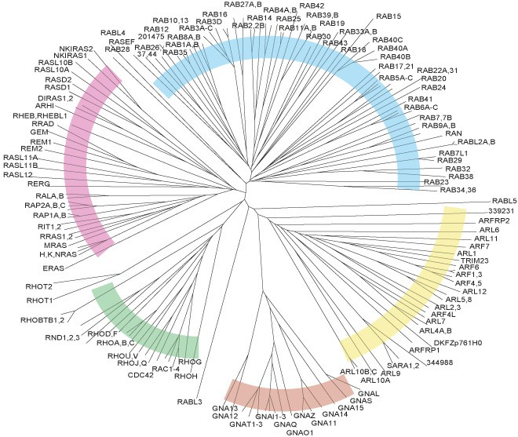
Radial Layouts – Applications
15 - 1
Phylogenetic tree
by Colicelli, ScienceSignaling, 2004

Slide 159
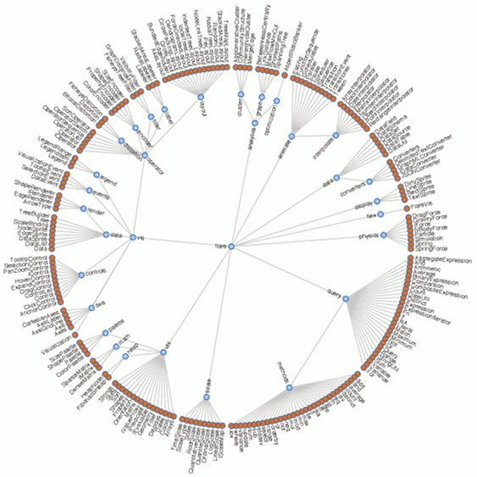
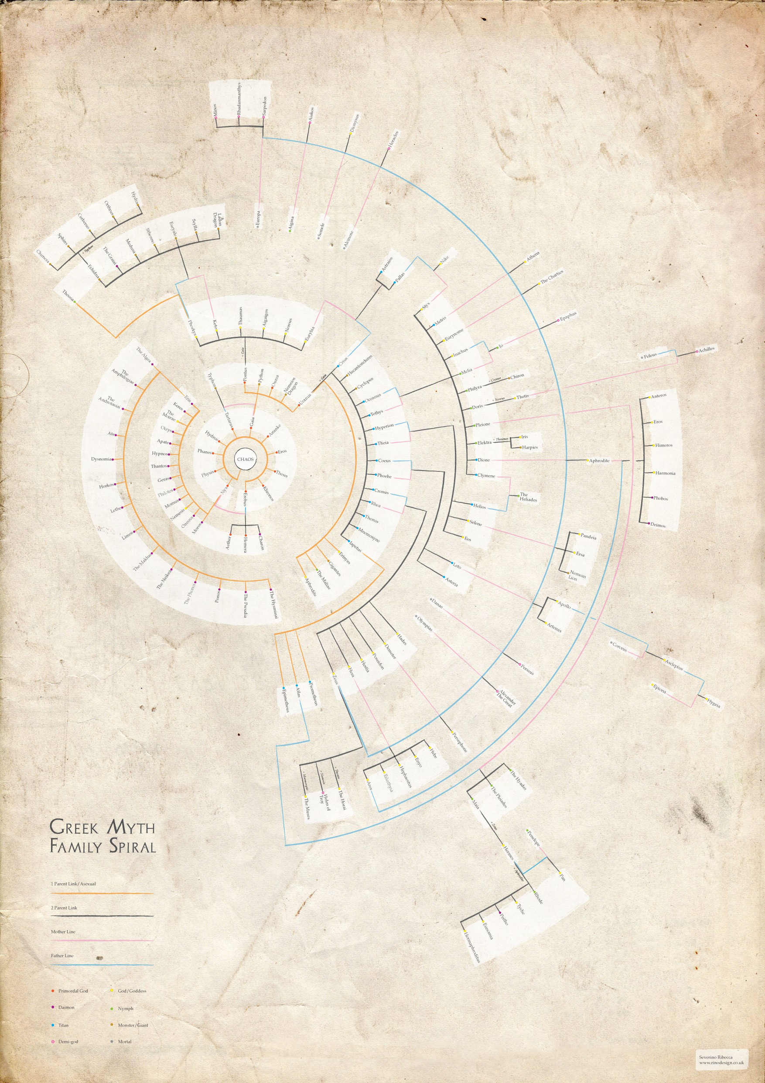
Radial Layouts – Applications
15 - 2
Flare Visualization Toolkit code structure by Heer, Bostock and Ogievetsky, 2010
Greek Myth Family by Ribecca, 2011

Slide 160
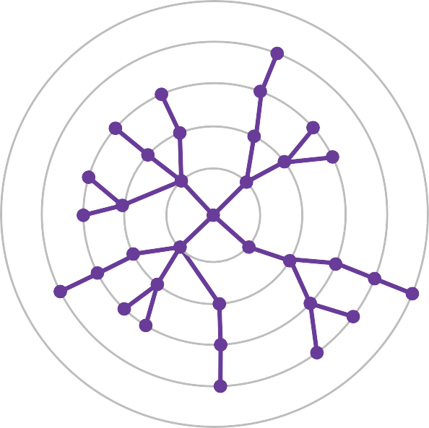
Radial Layouts – Drawing Style
16 - 1
Drawing conventions
■ Vertices lie on circular layers
according to their depth
■ Drawing is planar
Drawing aesthetics
■ Distribution of the vertices

Slide 161
Radial Layouts – Drawing Style
16 - 2
Drawing conventions
Vertices lie on circular layers according to their depth
Drawing aesthetics
■ Drawing is planar
■ Distribution of the vertices

Slide 162
Radial Layouts – Drawing Style
16 - 3
Drawing conventions
Vertices lie on circular layers according to their depth
Drawing is planar
Drawing aesthetics
■ Distribution of the vertices

Slide 163
Radial Layouts – Drawing Style
16 - 4
Drawing conventions
Vertices lie on circular layers according to their depth
Drawing is planar
Drawing aesthetics
Distribution of the vertices

Slide 164
Radial Layouts – Drawing Style
16 - 5
Drawing conventions
Vertices lie on circular layers according to their depth
Drawing is planar
Drawing aesthetics
Distribution of the vertices
How can an algorithm optimize the distribution of the vertices?

Slide 165
Radial Layouts – Algorithm Attempt
17 - 1
Idea
Reserve area corresponding to size .e(u) of T(u):
.e(u)
^{τu =} .e(v) − 1
■ Place u in middle of area

Slide 166
Radial Layouts – Algorithm Attempt
17 - 2
Idea
Reserve area corresponding to size .e(u) of T(u):
.e(u)
v
u
.e(u)
^{τu =} .e(v) − 1
■ Place u in middle of area

Slide 167
Radial Layouts – Algorithm Attempt
17 - 3
Idea
Reserve area corresponding to size .e(u) of T(u):
.e(u)
v
u
.e(u)
^{τu =} .e(v) − 1
■ Place u in middle of area

Slide 168
Radial Layouts – Algorithm Attempt
17 - 4
Idea
Reserve area corresponding to size .e(u) of T(u):
.e(u)
v
u
.e(u)
^{τu =} .e(v) − 1
■ Place u in middle of area
1
1
1
1
1
1

Slide 169
Radial Layouts – Algorithm Attempt
17 - 5
Idea
Reserve area corresponding to size .e(u) of T(u):
.e(u)
v
u
.e(u)
^{τu =} .e(v) − 1
■ Place u in middle of area
1
1
1
3
1
1
1

Slide 170
Radial Layouts – Algorithm Attempt
17 - 6
Idea
Reserve area corresponding to size .e(u) of T(u):
.e(u)
v
u
.e(u)
^{τu =} .e(v) − 1
■ Place u in middle of area
1
1
5
1
3
1
1
1

Slide 171
Radial Layouts – Algorithm Attempt
17 - 7
Idea
Reserve area corresponding to size .e(u) of T(u):
.e(u)
v
u
.e(u)
^{τu =} .e(v) − 1
■ Place u in middle of area
1
7
1
5
1
3
1
1
1

Slide 172
Radial Layouts – Algorithm Attempt
17 - 8
Idea
Reserve area corresponding to size .e(u) of T(u):
.e(u)
v
u
.e(u)
^{τu =} .e(v) − 1
■ Place u in middle of area
1
9
1
7
1
5
1
3
1
1

Slide 173
Radial Layouts – Algorithm Attempt
17 - 9
Idea
Reserve area corresponding to size .e(u) of T(u):
.e(u)
v
u
.e(u)
^{τu =} .e(v) − 1
■ Place u in middle of area
11
1
9
1
7
1
5
1
3
1
1

Slide 174
Radial Layouts – Algorithm Attempt
17 - 10
Idea
Reserve area corresponding to size .e(u) of T(u):
.e(u)
v
u
.e(u)
^{τu =} .e(v) − 1
11
■ Place u in middle of area
1
9
1
7
1
5
1
3
1
1

Slide 175
Radial Layouts – Algorithm Attempt
17 - 11
Idea
Reserve area corresponding to size .e(u) of T(u):
.e(u)
v
u
.e(u)
^{τu =} .e(v) − 1
Place u in middle of area
11
9
1
7
1
5
1
3
1
1
1

Slide 176

Radial Layouts – Algorithm Attempt
17 - 12
Idea
Reserve area corresponding to size .e(u) of T(u):
.e(u)
v
u
.e(u)
^{τu =} .e(v) − 1
Place u in middle of area
11
9
1
7
1
5
1
3
1
1
1

Slide 177
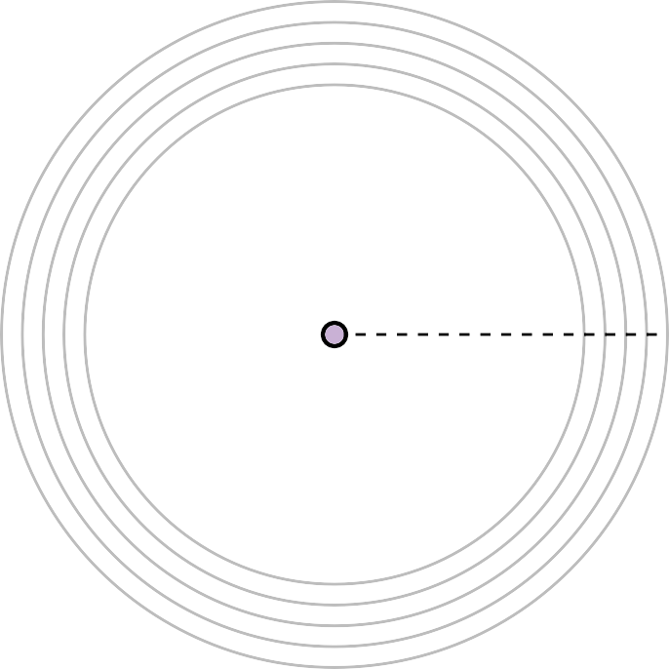
Radial Layouts – Algorithm Attempt
17 - 13
Idea
Reserve area corresponding to size .e(u) of T(u):
.e(u)
v
u
.e(u)
^{τu =} .e(v) − 1
Place u in middle of area
11
9
1
7
1
5
1
3
1
1
1

Slide 178
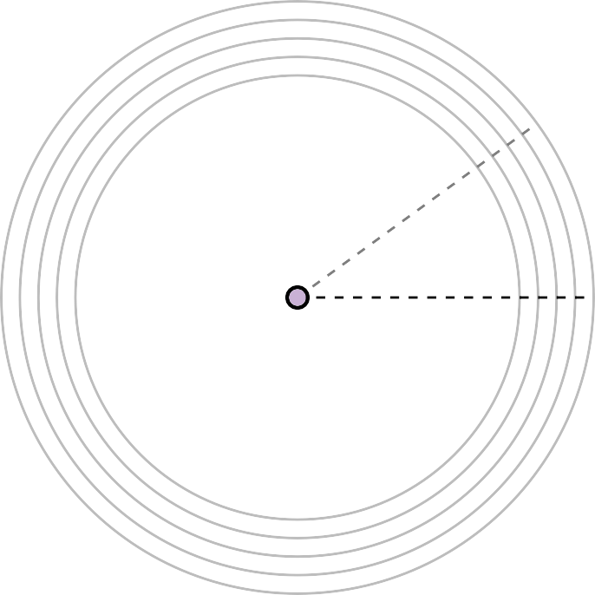
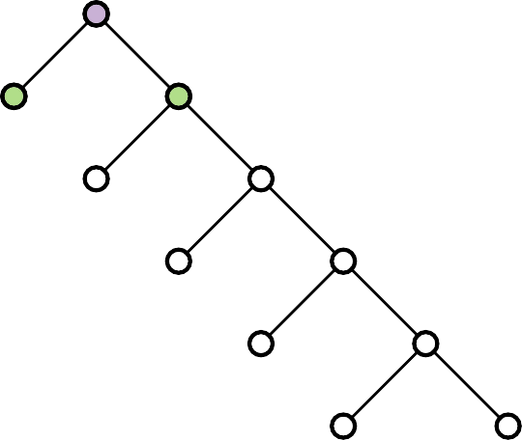
Radial Layouts – Algorithm Attempt
17 - 14
Idea
Reserve area corresponding to size .e(u) of T(u):
.e(u)
v
u
.e(u)
^{τu =} .e(v) − 1
Place u in middle of area
11
9
1
10
1
7
1
5
1
3
1
1
1

Slide 179
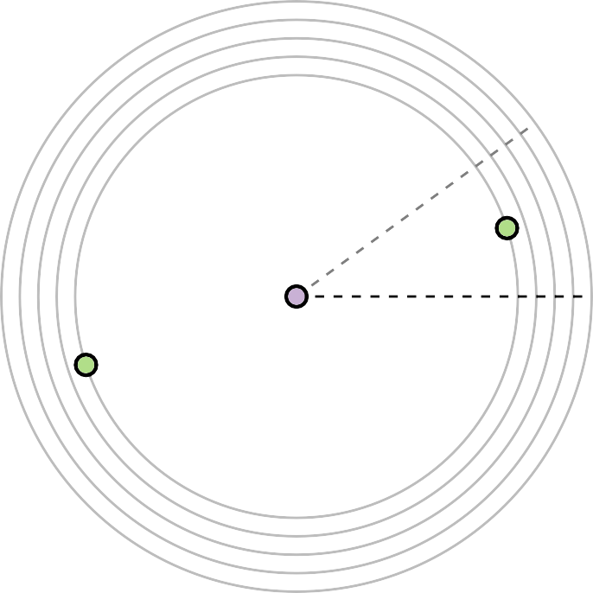
Radial Layouts – Algorithm Attempt
17 - 15
Idea
Reserve area corresponding to size .e(u) of T(u):
.e(u)
v
u
.e(u)
^{τu =} .e(v) − 1
Place u in middle of area
11
9
1
10
1
7
1
5
1
3
1
1
1

Slide 180
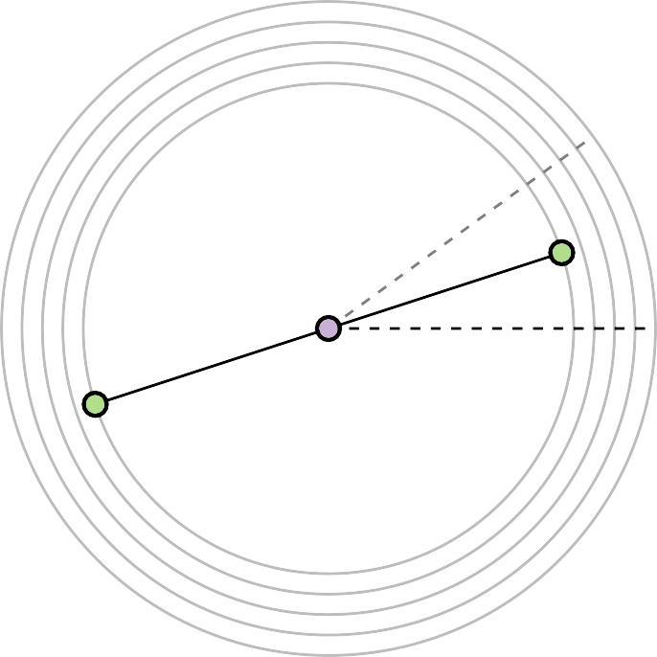
Radial Layouts – Algorithm Attempt
17 - 16
Idea
Reserve area corresponding to size .e(u) of T(u):
.e(u)
v
u
.e(u)
^{τu =} .e(v) − 1
Place u in middle of area
11
9
1
10
1
7
1
5
1
3
1
1
1

Slide 181
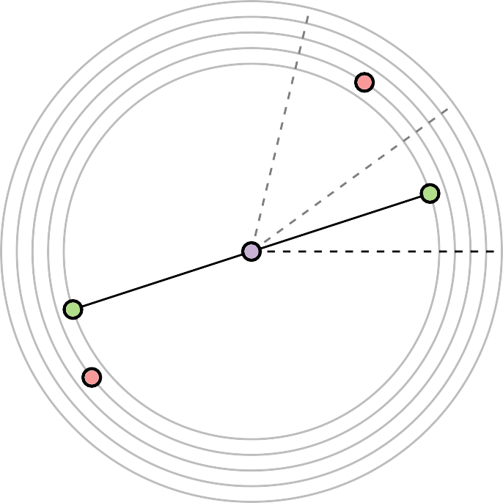
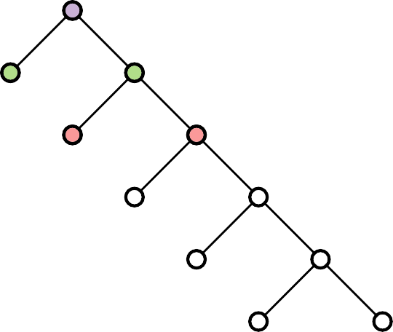
Radial Layouts – Algorithm Attempt
17 - 17
Idea
Reserve area corresponding to size .e(u) of T(u):
.e(u)
v
u
.e(u)
^{τu =} .e(v) − 1
Place u in middle of area
11
9
9 · 1
10 8
1
10
1
7
1
5
1
3
1
1
1

Slide 182
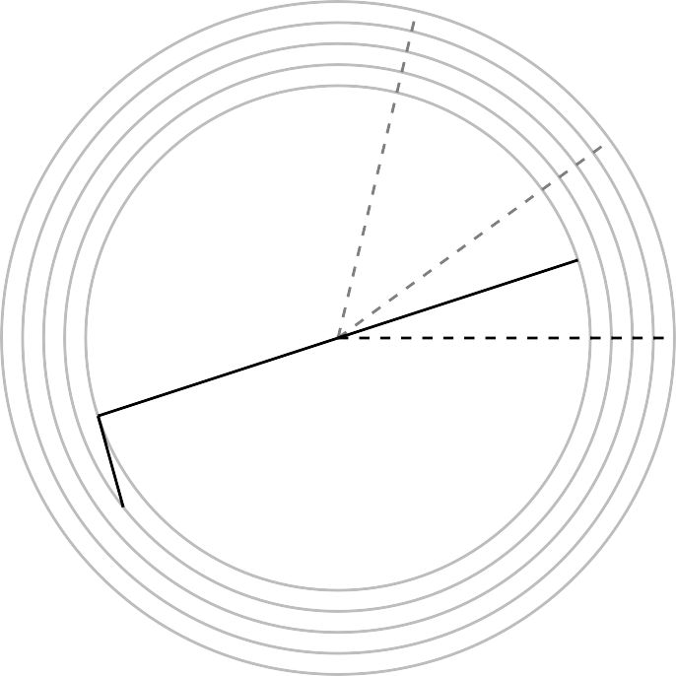
Radial Layouts – Algorithm Attempt
17 - 18
Idea
Reserve area corresponding to size .e(u) of T(u):
.e(u)
v
u
.e(u)
^{τu =} .e(v) − 1
Place u in middle of area
11
9
9 · 1
10 8
1
10
1
7
1
5
1
3
1
1
1

Slide 183
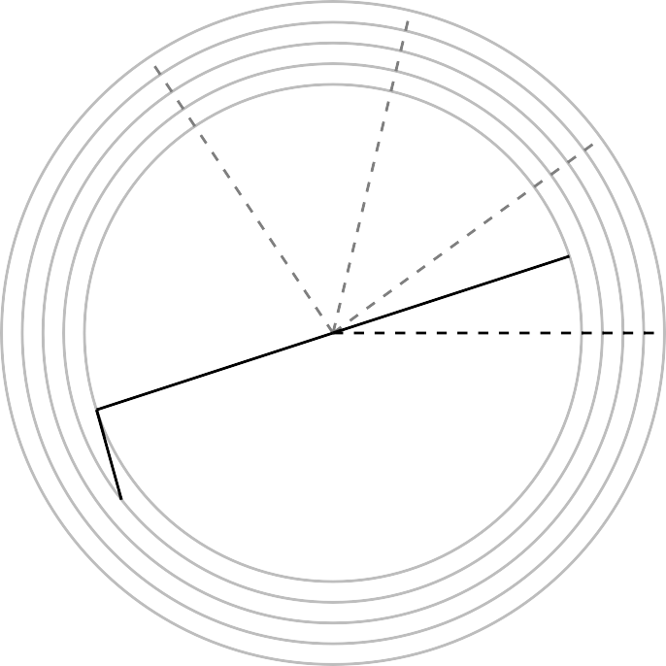
Radial Layouts – Algorithm Attempt
17 - 19
Idea
Reserve area corresponding to size .e(u) of T(u):
.e(u)
v
u
.e(u)
^{τu =} .e(v) − 1
Place u in middle of area
11
9
9 · 7 · 1
10 8 6
9 1
10 · 8
1
10
1
7
1
5
1
3
1
1
1

Slide 184
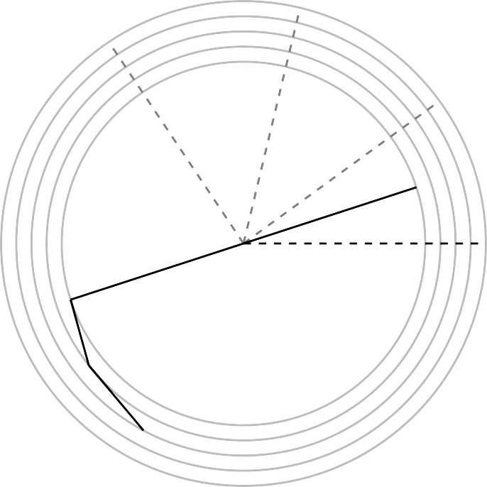

Radial Layouts – Algorithm Attempt
17 - 20
Idea
Reserve area corresponding to size .e(u) of T(u):
.e(u)
v
u
.e(u)
^{τu =} .e(v) − 1
Place u in middle of area
11
9
9 · 7 · 1
10 8 6
9 1
10 · 8
1
10
1
7
1
5
1
3
1
1
1

Slide 185
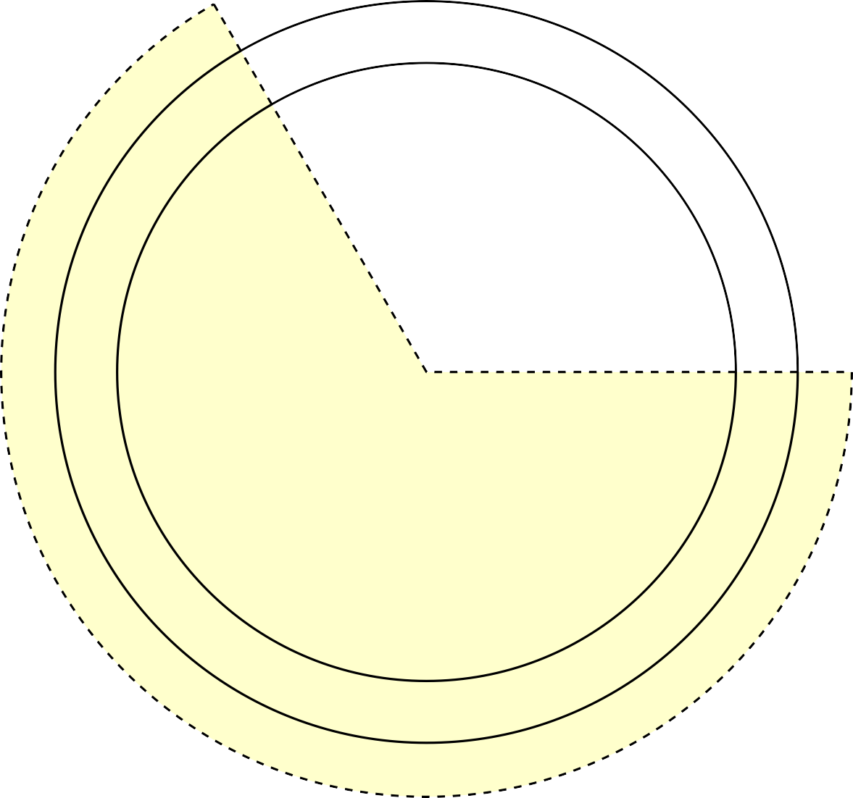
Radial Layouts – How To Avoid Crossings
18 - 1
p
v
u
q

Slide 186
Radial Layouts – How To Avoid Crossings
18 - 2
p
v
u
q

Slide 187
Radial Layouts – How To Avoid Crossings
18 - 3
p
v
u
q

Slide 188
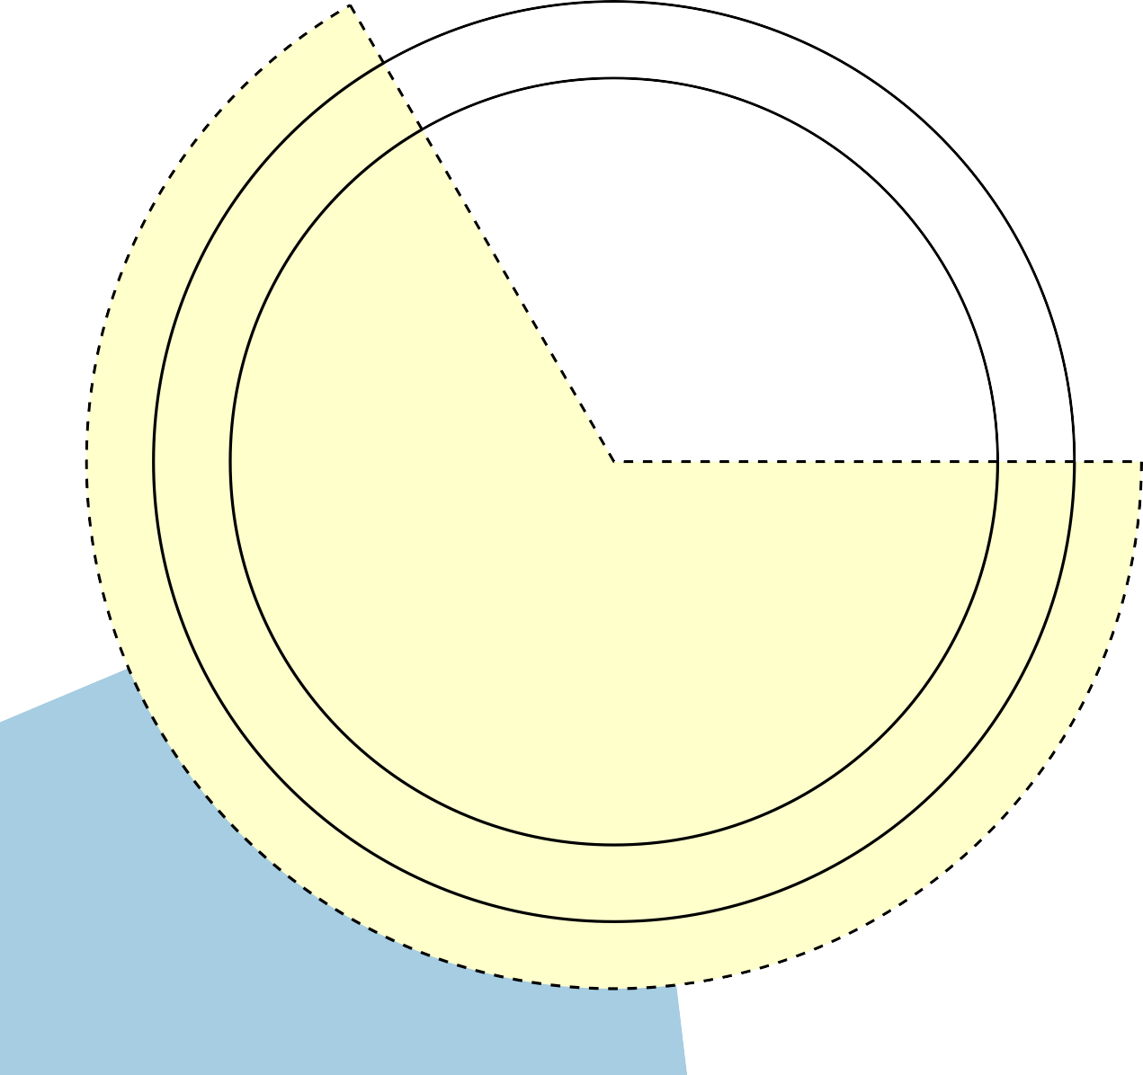
Radial Layouts – How To Avoid Crossings
18 - 4
p
v
u
q

Slide 189
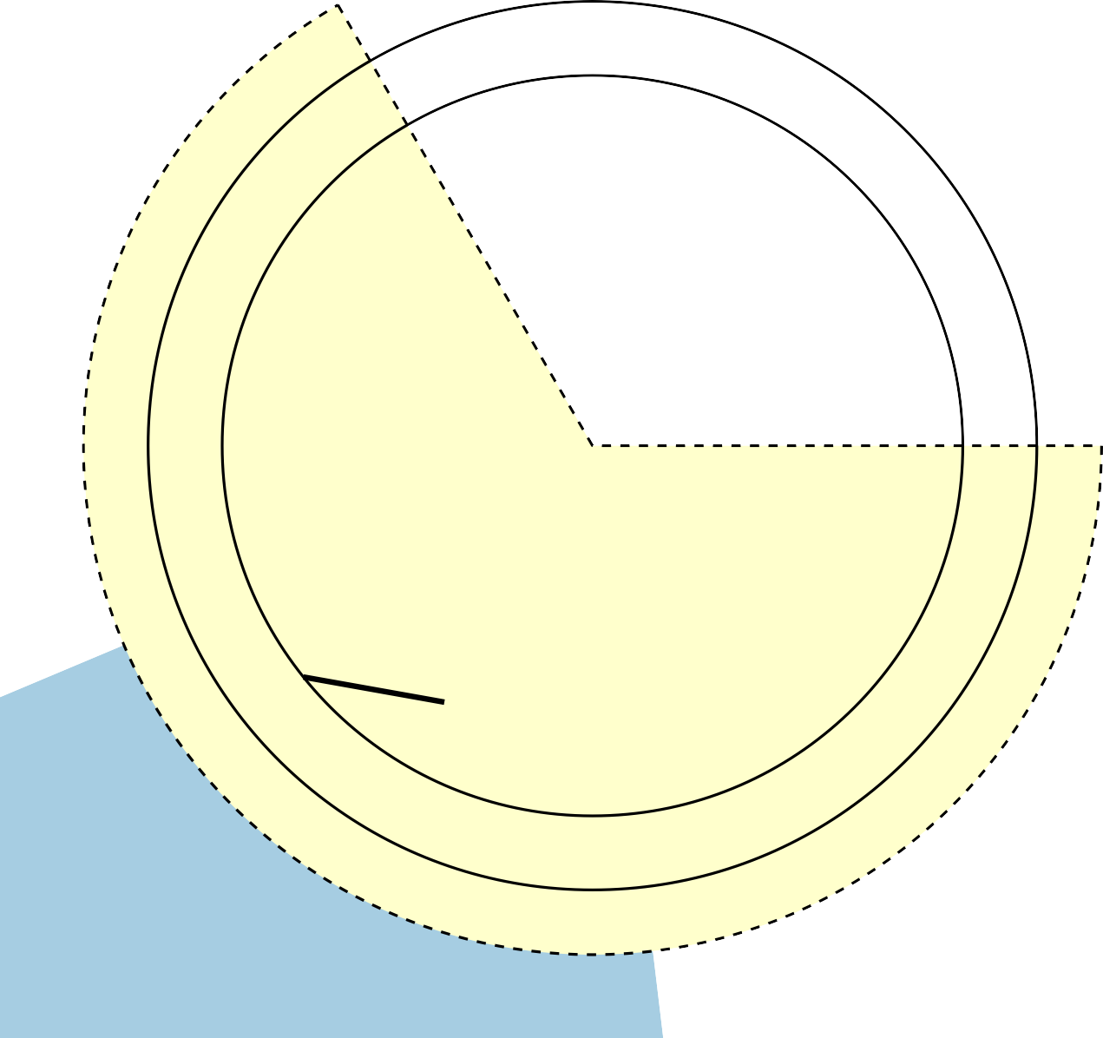
Radial Layouts – How To Avoid Crossings
18 - 5
v
p
u
q

Slide 190
Radial Layouts – How To Avoid Crossings
18 - 6
τ_{u} – angle of the wedge corre- sponding to vertex u
v
τ_{u}
p
u
q

Slide 191
Radial Layouts – How To Avoid Crossings
18 - 7
τ_{u} – angle of the wedge corre- sponding to vertex u
v
τ_{u}
2
p
u
q

Slide 192
Radial Layouts – How To Avoid Crossings
18 - 8
τ_{u} – angle of the wedge corre- sponding to vertex u
.e(u) – number of nodes in the subtree rooted at u
v
τ_{u}
2
p
u
q

Slide 193
Radial Layouts – How To Avoid Crossings
18 - 9
τ_{u} – angle of the wedge corre- sponding to vertex u
.e(u) – number of nodes in the subtree rooted at u
ρ_{i} – radius of layer i
v
τ_{u}
2
p
u
q

Slide 194
Radial Layouts – How To Avoid Crossings
18 - 10
τ_{u} – angle of the wedge corre- sponding to vertex u
.e(u) – number of nodes in the subtree rooted at u
ρ_{i} – radius of layer i
ρ_{i}
v
τ_{u}
2
p
u
q

Slide 195
Radial Layouts – How To Avoid Crossings
18 - 11
τ_{u} – angle of the wedge corre- sponding to vertex u
.e(u) – number of nodes in the subtree rooted at u
ρ_{i} – radius of layer i
^{ρ}i+1 ρ_{i}
v
τ_{u}
2
p
u
q

Slide 196
Radial Layouts – How To Avoid Crossings
18 - 12
τ_{u} – angle of the wedge corre- sponding to vertex u
.e(u) – number of nodes in the subtree rooted at u
ρ_{i} – radius of layer i
^{ρ}i+1 ρ_{i}
v
cos ^{τu} =
ρ_{i}
2
^{ρ}i+1
τ_{u}
2
p
u
q

Slide 197
Radial Layouts – How To Avoid Crossings
18 - 13
τ_{u} – angle of the wedge corre- sponding to vertex u
.e(u) – number of nodes in the subtree rooted at u
ρ_{i} – radius of layer i
^{ρ}i+1 ρ_{i}
v
cos ^{τu} =
ρ_{i}
2
^{ρ}i+1
τ_{u}
2
.e(u)
.e(v)−1
ρ_{i}
τ = min{
, 2 arccos
}
p
u
ρ
i+1
u
q

Slide 198



Radial Layouts – How To Avoid Crossings
18 - 14
τ_{u} – angle of the wedge corre- sponding to vertex u
.e(u) – number of nodes in the subtree rooted at u
ρ_{i} – radius of layer i
^{ρ}i+1 ρ_{i}
v
α_{u}
cos ^{τu} =
ρ_{i}
αmin
2
^{ρ}i+1
τ_{u}
2
.e(u)
.e(v)−1
ρ_{i}
τ = min{
, 2 arccos
}
p
u
ρ
i+1
u
Alternative:
α_{min} = α_{u} − arccos
α_{max} = α_{u} + arccos
q
ρ_{i}
^{ρ}i+1 ρ_{i}
αmax
^{ρ}i+1

Slide 199
Radial Layouts – Pseudocode
19 - 1
RadialTreeLayout(tree T, root r ∈ T, radii ρ₁ < · · · < ρ_{k} )
begin
postorder(r) preorder(r, 0, 0, 2π) return (d_{v}, α_{v} )_{v∈V(T)}
// vertex pos./polar coord.
postorder(vertex v)
.e(v) ← 1
foreach child w of v do
postorder(w)
.e(v) ← .e(v) + .e(w)

Slide 200
Radial Layouts – Pseudocode
19 - 2
RadialTreeLayout(tree T, root r ∈ T, radii ρ₁ < · · · < ρ_{k} )
begin
postorder(r) preorder(r, 0, 0, 2π) return (d_{v}, α_{v} )_{v∈V(T)}
// vertex pos./polar coord.
postorder(vertex v)
.e(v) ← 1
foreach child w of v do calculate the size of the subtree recursively
postorder(w)
.e(v) ← .e(v) + .e(w)

Slide 201
Radial Layouts – Pseudocode
19 - 3
RadialTreeLayout(tree T, root r ∈ T, radii ρ₁ < · · · < ρ_{k} )
begin
postorder(r) preorder(r, 0, 0, 2π) return (d_{v}, α_{v} )_{v∈V(T)}
// vertex pos./polar coord.
postorder(vertex v)
.e(v) ← 1
foreach child w of v do
postorder(w)
.e(v) ← .e(v) + .e(w)

Slide 202
Radial Layouts – Pseudocode
19 - 4
RadialTreeLayout(tree T, root r ∈ T, radii ρ₁ < · · · < ρ_{k} )
begin
postorder(r) preorder(r, 0, 0, 2π) return (d_{v}, α_{v} )_{v∈V(T)}
// vertex pos./polar coord.
preorder(vertex v, t, α_{min}, α_{max})
d_{v} ← ρ_{t}
α_{v} ← (α_{min} + α_{max})/2
if t > 0 then
α_{min} ← max{α_{min}, α_{v}−arccos ^{ρt} }
ρt+1
α_{max} ← min{α_{max}, α_{v} +arccos ^{ρt} }
ρt+1
left ← α_{min}
foreach child w of v do
right ← left + ^{.e(w)} ·(α_{max} − α_{min})
.e(v)−1
preorder(w, t + 1, left, right)
left ← right
postorder(vertex v)
.e(v) ← 1
foreach child w of v do
postorder(w)
.e(v) ← .e(v) + .e(w)

Slide 203
Radial Layouts – Pseudocode
19 - 5
RadialTreeLayout(tree T, root r ∈ T, radii ρ₁ < · · · < ρ_{k} )
begin
postorder(r) preorder(r, 0, 0, 2π) return (d_{v}, α_{v} )_{v∈V(T)}
// vertex pos./polar coord.
preorder(vertex v, t, α_{min}, α_{max}) d_{v} ← ρ_{t}
α_{v} ← (α_{min} + α_{max})/2
if t > 0 then
α_{min} ← max{α_{min}, α_{v}−arccos ^{ρt} }
ρt+1
α_{max} ← min{α_{max}, α_{v} +arccos ^{ρt} }
ρt+1
left ← α_{min}
foreach child w of v do
right ← left + ^{.e(w)} ·(α_{max} − α_{min})
.e(v)−1
preorder(w, t + 1, left, right)
left ← right
postorder(vertex v)
.e(v) ← 1
foreach child w of v do
postorder(w)
.e(v) ← .e(v) + .e(w)

Slide 204
Radial Layouts – Pseudocode
19 - 6
RadialTreeLayout(tree T, root r ∈ T, radii ρ₁ < · · · < ρ_{k} )
begin
postorder(r) preorder(r, 0, 0, 2π) return (d_{v}, α_{v} )_{v∈V(T)}
// vertex pos./polar coord.
preorder(vertex v, t, α_{min}, α_{max}) d_{v} ← ρ_{t}
α_{v} ← (α_{min} + α_{max})/2
if t > 0 then
α_{min} ← max{α_{min}, α_{v}−arccos ^{ρt} }
ρt+1
α_{max} ← min{α_{max}, α_{v} +arccos ^{ρt} }
ρt+1
left ← α_{min}
foreach child w of v do
right ← left + ^{.e(w)} ·(α_{max} − α_{min})
.e(v)−1
preorder(w, t + 1, left, right)
left ← right
postorder(vertex v)
.e(v) ← 1
foreach child w of v do
postorder(w)
.e(v) ← .e(v) + .e(w)

Slide 205
Radial Layouts – Pseudocode
19 - 7
RadialTreeLayout(tree T, root r ∈ T, radii ρ₁ < · · · < ρ_{k} )
begin
postorder(r) preorder(r, 0, 0, 2π) return (d_{v}, α_{v} )_{v∈V(T)}
// vertex pos./polar coord.
preorder(vertex v, t, α_{min}, α_{max})
d_{v} ← ρ_{t}
α_{v} ← (α_{min} + α_{max})/2
if t > 0 then
α_{min} ← max{α_{min}, α_{v}−arccos ^{ρt} }
ρt+1
α_{max} ← min{α_{max}, α_{v} +arccos ^{ρt} }
ρt+1
left ← α_{min}
foreach child w of v do
right ← left + ^{.e(w)} ·(α_{max} − α_{min})
.e(v)−1
preorder(w, t + 1, left, right)
left ← right
postorder(vertex v)
.e(v) ← 1
foreach child w of v do
postorder(w)
.e(v) ← .e(v) + .e(w)

Slide 206
Radial Layouts – Pseudocode
19 - 8
RadialTreeLayout(tree T, root r ∈ T, radii ρ₁ < · · · < ρ_{k} )
begin
postorder(r) preorder(r, 0, 0, 2π) return (d_{v}, α_{v} )_{v∈V(T)}
// vertex pos./polar coord.
preorder(vertex v, t, α_{min}, α_{max})
d_{v} ← ρ_{t}
α_{v} ← (α_{min} + α_{max})/2
//output
if t > 0 then
α_{min} ← max{α_{min}, α_{v}−arccos ^{ρt} }
ρt+1
α_{max} ← min{α_{max}, α_{v} +arccos ^{ρt} }
ρt+1
left ← α_{min}
foreach child w of v do
right ← left + ^{.e(w)} ·(α_{max} − α_{min})
.e(v)−1
preorder(w, t + 1, left, right)
left ← right
postorder(vertex v)
.e(v) ← 1
foreach child w of v do
postorder(w)
.e(v) ← .e(v) + .e(w)

Slide 207
Radial Layouts – Pseudocode
19 - 9
RadialTreeLayout(tree T, root r ∈ T, radii ρ₁ < · · · < ρ_{k} )
begin
postorder(r) preorder(r, 0, 0, 2π) return (d_{v}, α_{v} )_{v∈V(T)}
// vertex pos./polar coord.
preorder(vertex v, t, α_{min}, α_{max})
d_{v} ← ρ_{t}
α_{v} ← (α_{min} + α_{max})/2
//output
if t > 0 then
α_{min} ← max{α_{min}, α_{v}−arccos ^{ρt} }
ρt+1
α_{max} ← min{α_{max}, α_{v} +arccos ^{ρt}
ρt+1
}
postorder(vertex v)
.e(v) ← 1
foreach child w of v do
postorder(w)
.e(v) ← .e(v) + .e(w)
left ← α_{min}
foreach child w of v do
right ← left + ^{.e(w)} ·(α_{max} − α_{min})
.e(v)−1
preorder(w, t + 1, left, right)
left ← right

Slide 208
Radial Layouts – Pseudocode
19 - 10
RadialTreeLayout(tree T, root r ∈ T, radii ρ₁ < · · · < ρ_{k} )
begin
postorder(r) preorder(r, 0, 0, 2π) return (d_{v}, α_{v} )_{v∈V(T)}
// vertex pos./polar coord.
preorder(vertex v, t, α_{min}, α_{max})
d_{v} ← ρ_{t}
α_{v} ← (α_{min} + α_{max})/2
//output
if t > 0 then
α_{min} ← max{α_{min}, α_{v}−arccos
ρ_{t}
}
}
ρt+1 ρ_{t}
α_{max} ← min{α_{max}, α_{v} +arccos
ρt+1
postorder(vertex v)
.e(v) ← 1
foreach child w of v do
postorder(w)
.e(v) ← .e(v) + .e(w)
left ← α_{min}
foreach child w of v do
right ← left + ^{.e(w)} ·(α_{max} − α_{min})
.e(v)−1
preorder(w, t + 1, left, right)
left ← right

Slide 209
Radial Layouts – Pseudocode
19 - 11
RadialTreeLayout(tree T, root r ∈ T, radii ρ₁ < · · · < ρ_{k} )
begin
postorder(r) preorder(r, 0, 0, 2π) return (d_{v}, α_{v} )_{v∈V(T)}
// vertex pos./polar coord.
preorder(vertex v, t, α_{min}, α_{max})
d_{v} ← ρ_{t}
α_{v} ← (α_{min} + α_{max})/2
//output
if t > 0 then
α_{min} ← max{α_{min}, α_{v}−arccos
ρ_{t}
}
}
ρt+1 ρ_{t}
α_{max} ← min{α_{max}, α_{v} +arccos
ρt+1
postorder(vertex v)
.e(v) ← 1
foreach child w of v do
postorder(w)
.e(v) ← .e(v) + .e(w)
left ← α_{min}
foreach child w of v do
right ← left + ^{.e(w)} ·(α_{max} − α_{min})
.e(v)−1
preorder(w, t + 1, left, right)
left ← right

Slide 210
Radial Layouts – Pseudocode
19 - 12
RadialTreeLayout(tree T, root r ∈ T, radii ρ₁ < · · · < ρ_{k} )
begin
postorder(r) preorder(r, 0, 0, 2π) return (d_{v}, α_{v} )_{v∈V(T)}
// vertex pos./polar coord.
preorder(vertex v, t, α_{min}, α_{max})
d_{v} ← ρ_{t}
α_{v} ← (α_{min} + α_{max})/2
//output
if t > 0 then
α_{min} ← max{α_{min}, α_{v}−arccos
ρ_{t}
}
}
ρt+1 ρ_{t}
α_{max} ← min{α_{max}, α_{v} +arccos
ρt+1
postorder(vertex v)
.e(v) ← 1
foreach child w of v do
postorder(w)
.e(v) ← .e(v) + .e(w)
left ← α_{min}
foreach child w of v do
right ← left + ^{.e(w)} ·(α_{max} − α_{min})
.e(v)−1
preorder(w, t + 1, left, right)
left ← right

Slide 211
Radial Layouts – Pseudocode
19 - 13
RadialTreeLayout(tree T, root r ∈ T, radii ρ₁ < · · · < ρ_{k} )
begin
postorder(r) preorder(r, 0, 0, 2π) return (d_{v}, α_{v} )_{v∈V(T)}
// vertex pos./polar coord.
preorder(vertex v, t, α_{min}, α_{max})
d_{v} ← ρ_{t}
α_{v} ← (α_{min} + α_{max})/2
//output
if t > 0 then
α_{min} ← max{α_{min}, α_{v}−arccos
ρ_{t}
}
}
ρt+1 ρ_{t}
α_{max} ← min{α_{max}, α_{v} +arccos
ρt+1
postorder(vertex v)
.e(v) ← 1
foreach child w of v do
postorder(w)
.e(v) ← .e(v) + .e(w)
left ← α_{min}
foreach child w of v do
right ← left + ^{.e(w)} ·(α_{max} − α_{min})
.e(v)−1
preorder(w, t + 1, left, right)
left ← right

Slide 212
Radial Layouts – Pseudocode
19 - 14
RadialTreeLayout(tree T, root r ∈ T, radii ρ₁ < · · · < ρ_{k} )
begin
postorder(r) preorder(r, 0, 0, 2π) return (d_{v}, α_{v} )_{v∈V(T)}
// vertex pos./polar coord.
preorder(vertex v, t, α_{min}, α_{max})
d_{v} ← ρ_{t}
α_{v} ← (α_{min} + α_{max})/2
//output
if t > 0 then
α_{min} ← max{α_{min}, α_{v}−arccos
ρ_{t}
}
}
ρt+1 ρ_{t}
α_{max} ← min{α_{max}, α_{v} +arccos
ρt+1
postorder(vertex v)
.e(v) ← 1
foreach child w of v do
postorder(w)
.e(v) ← .e(v) + .e(w)
left ← α_{min}
foreach child w of v do
right ← left + ^{.e(w)} ·(α_{max} − α_{min})
.e(v)−1
preorder(w, t + 1, left, right)
left ← right

Slide 213
Radial Layouts – Pseudocode
19 - 15
RadialTreeLayout(tree T, root r ∈ T, radii ρ₁ < · · · < ρ_{k} )
begin
postorder(r) preorder(r, 0, 0, 2π) return (d_{v}, α_{v} )_{v∈V(T)}
// vertex pos./polar coord.
preorder(vertex v, t, α_{min}, α_{max})
d_{v} ← ρ_{t}
α_{v} ← (α_{min} + α_{max})/2
//output
if t > 0 then
α_{min} ← max{α_{min}, α_{v}−arccos
ρ_{t}
}
}
ρt+1 ρ_{t}
α_{max} ← min{α_{max}, α_{v} +arccos
ρt+1
postorder(vertex v)
.e(v) ← 1
foreach child w of v do
postorder(w)
.e(v) ← .e(v) + .e(w)
left ← α_{min}
foreach child w of v do
right ← left + ^{.e(w)} ·(α_{max} − α_{min})
.e(v)−1
preorder(w, t + 1, left, right)
left ← right

Slide 214
Radial Layouts – Pseudocode
19 - 16
RadialTreeLayout(tree T, root r ∈ T, radii ρ₁ < · · · < ρ_{k} )
begin
postorder(r) preorder(r, 0, 0, 2π) return (d_{v}, α_{v} )_{v∈V(T)}
// vertex pos./polar coord.
preorder(vertex v, t, α_{min}, α_{max})
d_{v} ← ρ_{t}
α_{v} ← (α_{min} + α_{max})/2
//output
if t > 0 then
α_{min} ← max{α_{min}, α_{v}−arccos
ρ_{t}
}
}
ρt+1 ρ_{t}
α_{max} ← min{α_{max}, α_{v} +arccos
ρt+1
postorder(vertex v)
.e(v) ← 1
foreach child w of v do
postorder(w)
.e(v) ← .e(v) + .e(w)
left ← α_{min}
foreach child w of v do
right ← left + ^{.e(w)} ·(α_{max} − α_{min})
.e(v)−1
preorder(w, t + 1, left, right)
left ← right
Runtime?

Slide 215
Radial Layouts – Pseudocode
19 - 17
RadialTreeLayout(tree T, root r ∈ T, radii ρ₁ < · · · < ρ_{k} )
begin
postorder(r) preorder(r, 0, 0, 2π) return (d_{v}, α_{v} )_{v∈V(T)}
// vertex pos./polar coord.
preorder(vertex v, t, α_{min}, α_{max})
d_{v} ← ρ_{t}
α_{v} ← (α_{min} + α_{max})/2
//output
if t > 0 then
α_{min} ← max{α_{min}, α_{v}−arccos
ρ_{t}
}
}
ρt+1 ρ_{t}
α_{max} ← min{α_{max}, α_{v} +arccos
ρt+1
postorder(vertex v)
.e(v) ← 1
foreach child w of v do
postorder(w)
.e(v) ← .e(v) + .e(w)
left ← α_{min}
foreach child w of v do
right ← left + ^{.e(w)} ·(α_{max} − α_{min})
.e(v)−1
preorder(w, t + 1, left, right)
left ← right
Runtime?
O(n)

Slide 216
Radial Layouts – Pseudocode
19 - 18
RadialTreeLayout(tree T, root r ∈ T, radii ρ₁ < · · · < ρ_{k} )
begin
postorder(r) preorder(r, 0, 0, 2π) return (d_{v}, α_{v} )_{v∈V(T)}
// vertex pos./polar coord.
preorder(vertex v, t, α_{min}, α_{max})
d_{v} ← ρ_{t}
α_{v} ← (α_{min} + α_{max})/2
//output
if t > 0 then
α_{min} ← max{α_{min}, α_{v}−arccos
ρ_{t}
}
}
ρt+1 ρ_{t}
α_{max} ← min{α_{max}, α_{v} +arccos
ρt+1
postorder(vertex v)
.e(v) ← 1
foreach child w of v do
postorder(w)
.e(v) ← .e(v) + .e(w)
left ← α_{min}
foreach child w of v do
right ← left + ^{.e(w)} ·(α_{max} − α_{min})
.e(v)−1
preorder(w, t + 1, left, right)
left ← right
Runtime?
O(n)
Correctness?

Slide 217
Radial Layouts – Pseudocode
19 - 19
RadialTreeLayout(tree T, root r ∈ T, radii ρ₁ < · · · < ρ_{k} )
begin
postorder(r) preorder(r, 0, 0, 2π) return (d_{v}, α_{v} )_{v∈V(T)}
// vertex pos./polar coord.
preorder(vertex v, t, α_{min}, α_{max})
d_{v} ← ρ_{t}
α_{v} ← (α_{min} + α_{max})/2
//output
if t > 0 then
α_{min} ← max{α_{min}, α_{v}−arccos
ρ_{t}
}
}
ρt+1 ρ_{t}
α_{max} ← min{α_{max}, α_{v} +arccos
ρt+1
postorder(vertex v)
.e(v) ← 1
foreach child w of v do
postorder(w)
.e(v) ← .e(v) + .e(w)
left ← α_{min}
foreach child w of v do
right ← left + ^{.e(w)} ·(α_{max} − α_{min})
.e(v)−1
preorder(w, t + 1, left, right)
left ← right
Runtime?
O(n)
Correctness?
✓

Slide 218
Radial Layouts – Result
20 - 1
Theorem.
Let T be a tree with n vertices. The RadialTreeLayout algorithm constructs in O(n) time a drawing Γ of T s.t.:
■ Γ is radial drawing
■ Vertices lie on circle according to their depth
■ Area quadratic in max degree times height of T
(see [GD Ch. 3.1.3] if interested)

Slide 219
Radial Layouts – Result
20 - 2
Theorem.
Let T be a tree with n vertices. The RadialTreeLayout algorithm constructs in O(n) time a drawing Γ of T s.t.:
Γ is radial drawing
■ Vertices lie on circle according to their depth
■ Area quadratic in max degree times height of T
(see [GD Ch. 3.1.3] if interested)

Slide 220
Radial Layouts – Result
20 - 3
Theorem.
Let T be a tree with n vertices. The RadialTreeLayout algorithm constructs in O(n) time a drawing Γ of T s.t.:
Γ is radial drawing
Vertices lie on circle according to their depth
■ Area quadratic in max degree times height of T
(see [GD Ch. 3.1.3] if interested)

Slide 221
Radial Layouts – Result
20 - 4
Theorem.
Let T be a tree with n vertices. The RadialTreeLayout algorithm constructs in O(n) time a drawing Γ of T s.t.:
Γ is radial drawing
Vertices lie on circle according to their depth
Area quadratic in max degree times height of T
(see [GD Ch. 3.1.3] if interested)

Slide 222
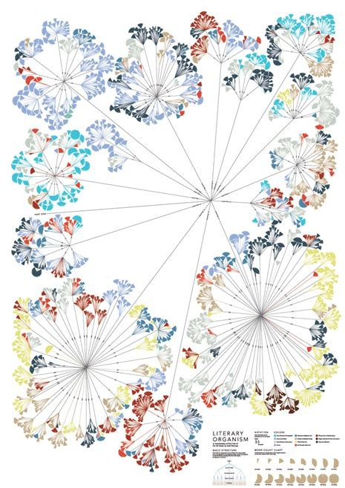
Other Tree Visualization Styles
21 - 1
Writing Without Words:
The project explores methods to visualizes the differences in writing styles of different authors.
Similar to ballon layout

Slide 223
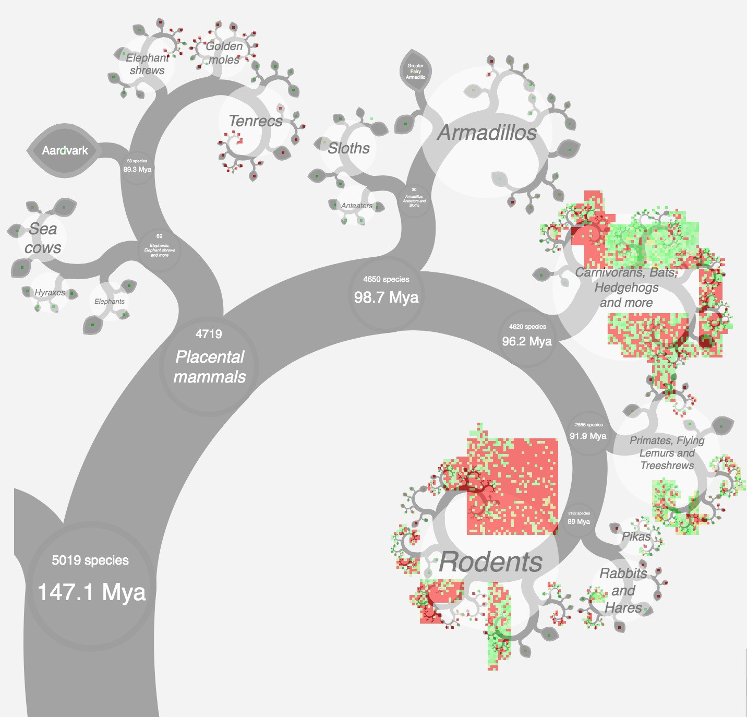
Other Tree Visualization Styles
21 - 2
A phylogenetically organised display of data for all placental mammal species.
Fractal layout

Slide 224

Other Tree Visualization Styles
21 - 3
A language family tree – in pictures
Fractal layout

Slide 225

Other Tree Visualization Styles
21 - 4

Slide 226
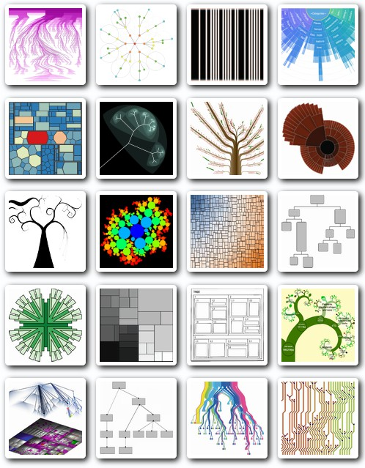
Other Tree Visualization Styles
21 - 5
treevis.net

